Slide 1

CCLG Board Certification Study Group
Public Records & Sunshine Law
St. Petersburg
Police Department
Allyson Smith

Slide 2


Public Records Law Overview and Update

Slide 3
Scope of Public Records Act
1. Florida’s Public Records Act, Ch. 119, F.S., provides a right of access to the records of state and local governments as well as to records of private entities acting on their behalf.

Slide 4
Scope of Public Records Act
In the absence of statutory exemption, this right of access applies to
All “documents, papers, letters, maps, books, tapes, photographs, films, sound recordings, data processing software or other material, regardless of the physical form, characteristics, or means of transmission”
made or received pursuant to law or ordinance or in connection with the transaction of official business
by any agency [includes a private entity “acting on behalf” of a public agency]
which are used to perpetuate, communicate, or formalize knowledge.

Slide 5
Some common exemptions
Pending litigation
Ongoing criminal intelligence
Home addresses, etc. of certain individuals
Security plans
Certain victims – including Marsy’s Law
**Notably doing public work on private devices does not exempt those records from PRRs**

Slide 6
How it works in practice
Receive request
No written requirement
No reason requirement
No name of requestor required
May charge a fee for production
(d) If the nature or volume of public records requested to be inspected or copied pursuant to this subsection is such as to require extensive use of information technology resources or extensive clerical or supervisory assistance by personnel of the agency involved, or both, the agency may charge, in addition to the actual cost of duplication, a special service charge, which shall be reasonable and shall be based on the cost incurred for such extensive use of information technology resources or the labor cost of the personnel providing the service that is actually incurred by the agency or attributable to the agency for the clerical and supervisory assistance required, or both.

Slide 7
Scope of Public Records Act
Example: NCAA v. Associated Press, 18 So. 3d 1201 (Fla. 1st DCA 2009), review denied, 37 So. 3d 848 (Fla. 2010)
“Records created and maintained by the NCAA are not generally subject to disclosure. However, the documents at issue in this case were examined by lawyers for a public agency, Florida State University, and used in the course of the agency’s business.
Because the documents were received in connection with the transaction of official business by an agency, they are public records. The NCAA has failed to show that an exception applies under state or federal law, and thus, the records must be disclosed.”

Slide 8
Public records case update
Roldan v. City of Hallandale Beach, 361 So.3d 348 (Fla. 4th DCA 2023). Fla. Stat. 119.12(1) allows for the recovery of attorney’s fees in a civil action filed against an agency to enforce the provisions of this chapter if 1) the agency unlawfully refused to permit a public record to be inspected and 2) the complainant provided written notice identifying the public record request to the agency’s custodian at least 5 business days before filing the civil action.
A requestor’s single written request for public records could not serve as the “written notice identifying the public records request” required to recover attorney’s fees under section 119.12(1)(b), Florida Statutes.
This case was also specifically referenced in a PCA in Stern v. DeSantis, 376 So.3d 78 (Fla. 1st DCA 2023).

Slide 9
Public records case update
Bivens v. Tony, 368 So.3d 16 (Fla. 4th DCA 2023)
PCA with comment affirming denial of mandamus because the requestor did not request the production of records for inspection, but instead asked the Sheriff to respond to several questions about an employee’s qualifications. “Nothing in 119.01 or the Florida Constitution requires agencies to pore through their own records to answer specific questions.”

Slide 10
Public records case update
City of Pembroke Pines v. Town of Southwest Ranches, 362 So.3d 223 (Fla 4th DCA 2023).
Pembroke Pines made a public records request to Southwest Ranches for records related to Southwest Ranches attorney’s fees and expenses related to litigation between these two governments. Southwest Ranches claimed these records were exempt because litigation was ongoing and refused to produce any records. After Pembroke Pines gave notice of suit and filed pursuant to Chapter 119, Southwest Ranches filed a Motion to Dismiss for failure to exhaust administrative remedies pursuant to Fla. Stat. 164.1041.
Court ruled that Chapter 119 does not fall into the provided exceptions specifically stated in Fla. Stat. 164.1041(1) and so a public records suit may not be initiated between governmental entities until it has exhausted alternative dispute resolution procedures pursuant to Chapter 164.

Slide 11
Public records case update
Mozie v. State, 368 So.3d 512 (Fla. 3d DCA 2023)
PCA with note that the state attorney’s files become public records, with certain exceptions, after a defendant’s sentence becomes final and that the indigent defendant is not entitled to receive copies of such public records free of charge.

Slide 12
Public records case update
School District of Lee County v. Bracci, P.A., 365 So.3d 505 (Fla. 6th DCA 2023)
Bracci, P.A. made a public records request to the school board including a request for the School Board’s Chief of Staff in connection with individual phone calls made between the superintendent and the School Board members.
The trial court ruled that the School Board needs to produce those documents and specifically stated that the notes “are akin to minutes documenting what appears to be polling of the school board members as to whether or not the board members supported the recommendation of the superintendent to terminate the…contract.”
The appellate court found the trial court’s order to be in error in that the factual conclusion indicating what the notes documented is unsupported.

Slide 13
Marsy’s law
Every victim in Florida is entitled to various rights beginning at the time of his/her victimization. These rights include the right to prevent the disclosure of information or records that could be used to locate or harass the victim or the victim’s family, or which could disclose confidential or privileged information of the victim. A victim is “a person who suffers direct or threatened physical, psychological, or financial harm as a result of the commission or attempted commission of a crime or delinquent act or against whom the crime or delinquent act is committed.”

Slide 14
Public Records Case Update
Florida Police Benevolent Association, Inc. v. City of Tallahassee, 314 So. 3d 796 (Fla. 1st DCA 2021), review granted, No. 21-651 (Fla. December 21, 2021)
The identity of officers who were threatened with deadly force by crime suspects and who then responded by killing the suspects is confidential under Marsy’s Law. The court rejected the trial judge’s conclusion that Marsy’s Law did not shield the identity of law enforcement officers acting in the course of their official duties. The appellate court noted that Marsy’s Law would not halt an internal affairs investigation nor impede any grand jury investigation. Also, if the State Attorney determines that the officer was not a victim and instead charges the officer for his conduct, the Marsy’s Law protections would not apply.

Slide 15
Public Records Case Update
City of Tallahassee v. Florida Police Benevolent Association, Inc. v. City of Tallahassee, 375 So. 3d 178 (Fla. 2023)
The Supreme Court identified 3 questions, but ultimately boiled down to answering just one. Does Marsy’s Law contain a right for victims to remain anonymous? They ruled that Marsy’s Law guarantees to no victim – police officer or otherwise – the categorical right to withhold his or her name from disclosure.

Slide 16
Public records case update
Jackson v. City of South Bay, 358 So.3d 18 (Fla.4th DCA 2023)
Jackson ran for South Bay City Commissioner in March 2020 and lost by one vote. In April 2020, Jackson issued a public records request, requesting copies of the canvassing board meeting minutes pertaining to the election. Jackson filed a complaint contesting the election and later alleging violations of Florida’s Sunshine Law and Florida Public Records Act.
All of the meeting minutes were produced except for a March 13th meeting as the City was unaware that a meeting had occurred that day due to it not appearing on calendars. Upon discovering the minutes, the City provided them in September 2020. The appellate court found no violation of the Public Records law as the City had complied with the request before the agreed upon date and the March minutes were promptly provided upon discovery and that constituted a “good faith response.”
But wait, there’s more…

Slide 17

Sunshine Law Overview and Update

Slide 18
Scope of Sunshine Law—Section 286.011, F.S.
The Sunshine Law applies to any gathering of two or more members of an elected or appointed public collegial board when they meet to discuss any matter which will foreseeably come before that board for action. Advisory committees can be included even though their powers are limited to making recommendations. Staff committees can be subject to the Sunshine Law if they have been delegated some “decision-making” authority (such as the authority to screen and rank proposals) as opposed to mere fact-finding or information-gathering.

Slide 19

Scope of Sunshine Law—Section 286.011, F.S.
Example: Sarasota Citizens for Responsible Government v. City of Sarasota, 48 So. 3d 775 (Fla. 2010)
“All governmental entities in Florida are subject to the requirements of the Sunshine Law unless specifically exempted.” However, a county administrator’s discussions with staff and consultants while negotiating a memorandum of understanding with a baseball team did not violate the Sunshine Law because the administrator’s “so-called negotiations team only served an informational role . . . .”

Slide 20
Requirements of the Sunshine Law
Meetings must be open to the public
Reasonable public notice of such meetings must be given; and
Minutes of the meetings must be promptly prepared and open to public inspection.

Slide 21
Public records case update
Jackson v. City of South Bay, 358 So.3d 18 (Fla.4th DCA 2023)
Jackson also argued that the City violated the Sunshine Law by failing to promptly record and make available for public inspection meeting minutes from the March 13th meeting.
“The minutes of a meeting of any such board or commission of any such state agency or authority shall be promptly recorded, and such records shall be open to public inspection.” Fla. Stat. 286.011(2). Because the City of unaware of the existence of the March 13 meeting, the minutes were not promptly recorded and open to public inspection and therefore the City violated the Sunshine Law.

Slide 22
Public records case update
Burton v. Oates, 362 So.3d 311 (Fla. 5th DCA 2023)
Briefly addresses that “open to the public” does not add the requirement of in person.

Slide 23
Public records case update
Gilliams v. State, 359 So.3d 784 (Fla. 4th DCA 2023)
The City of Sebastian’s city manager announced a cancellation of a properly noticed city council meeting. Three councilmembers, including Gilliams, held the meeting anyway and voted to terminate the employment of the city manager, city attorney, and city clerk, and voted to remove the mayor and replace him with Gilliams.
Gilliams argue the Sunshine Law, specifically, the terms “meeting” and “reasonable notice” were unconstitutionally vague. The appellate court disagreed.
Parris v. State, 359 So.3d 1178 (Fla. 4th DCA 2023) is one of the other councilmember’s cases

Slide 24
Public records case update
Miller v. State, 373 So.3d 945 (Fla. 5th DCA 2023)
Miller was elected to the Sumter County Commission and took office November 2020. The State Attorney’s Office received three Sunshine Law complaints that Miller’s wife served as a conduit for communications between Miller and other commissioners and for his failure to maintain public records relating to his use of Facebook.
Miller gave a sworn statement during this investigation and was ultimately charged and convicted of perjury.

Slide 25
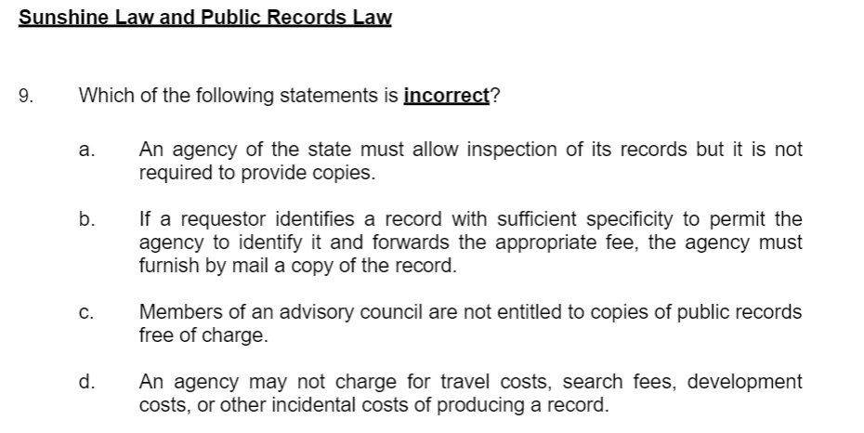
Exam questions
Answer: A

Slide 26
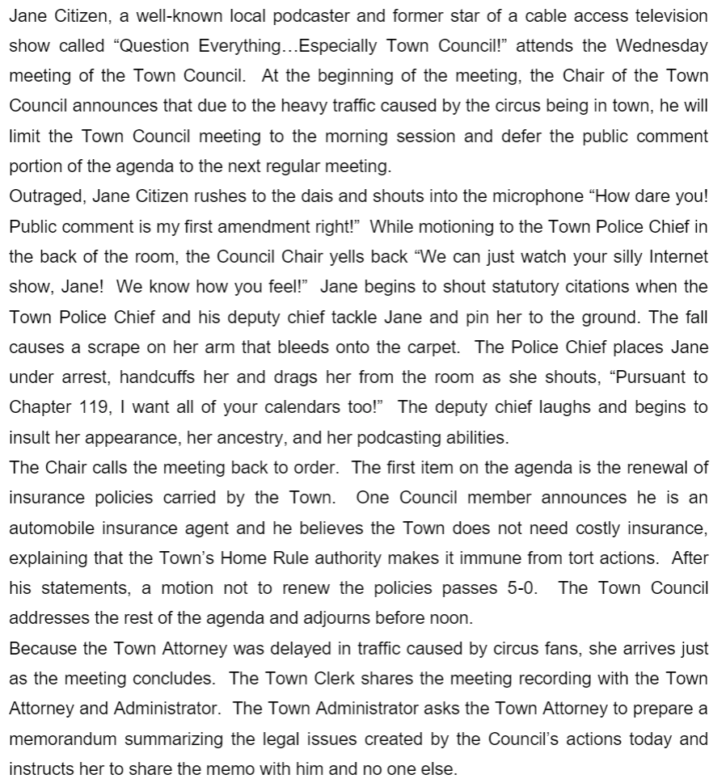
Exam questions

Slide 27
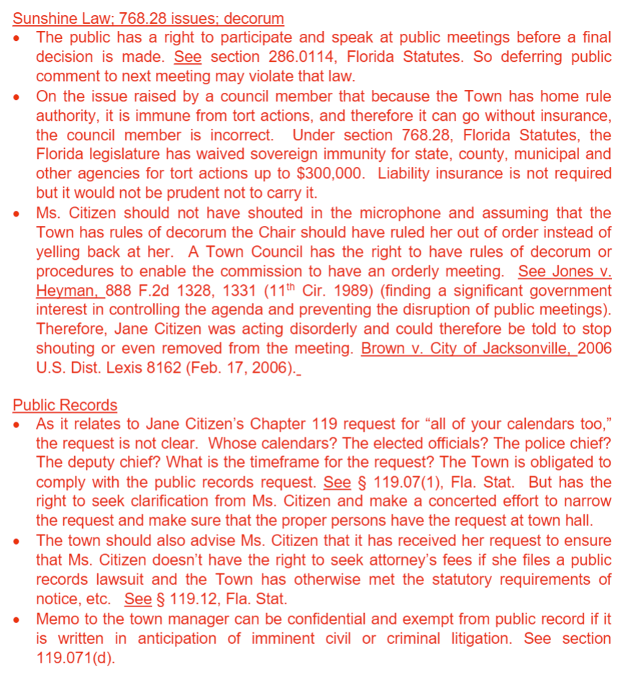
Answer

Slide 28
Resources
Government in the Sunshine Manual
Public Records: A Guide For Law Enforcement Agencies
City, County, and Local Government Law Certification Sample Exam

