Slide 1
PROCUREMENT & CONTRACTS
KIRSTEN MOOD | NABORS GIBLIN & NICKERSON | TALLAHASSEE

Slide 2
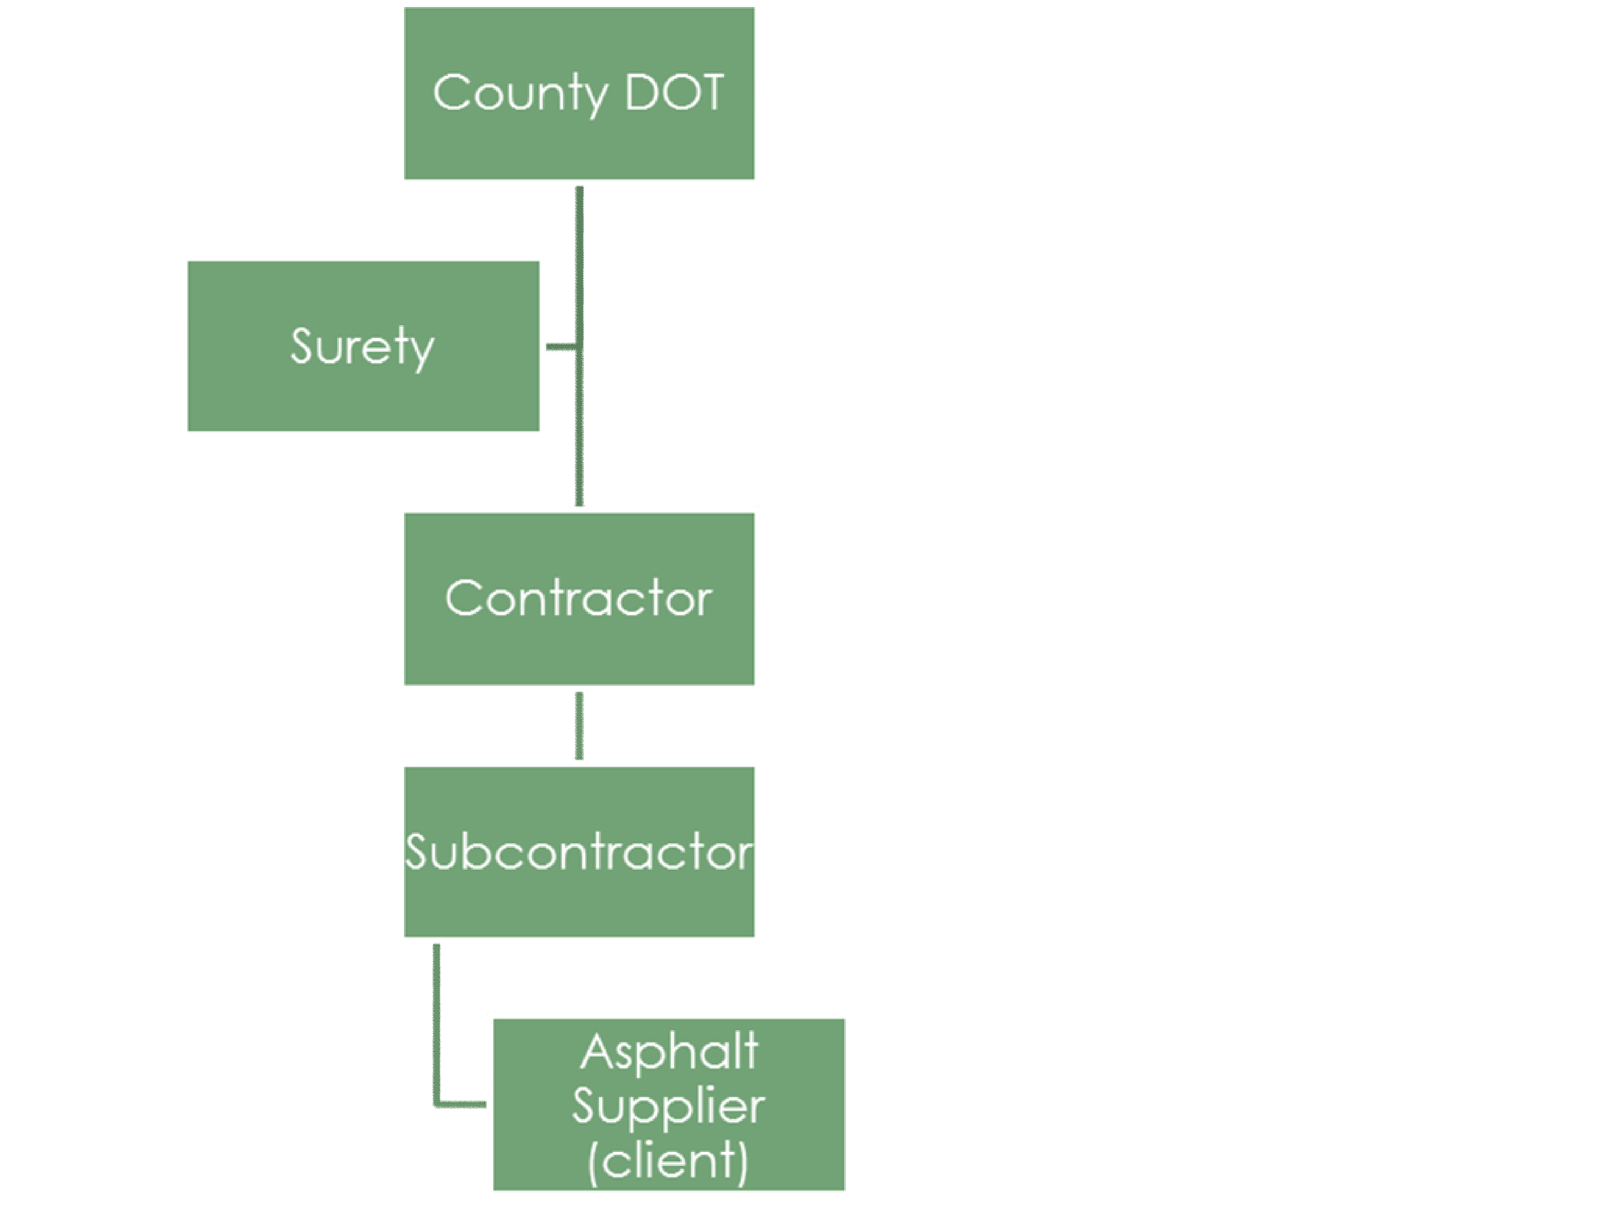
Framework
A person entering into a formal contract with the state or any county, city, or political subdivision thereof, or other public authority or private entity, for the construction of a public building, for the prosecution and completion of a public work, or for repairs upon a public building or public work shall be required …

Slide 3
Governing Law: Common Law
No Common Law requirement to competitively bid
Absent specific law or rule, any reasonable method of procurement can be used.
Public policy favors competitive procurement whenever possible. Op. Att’y Gen. Fla. 66-9 (1966).

Slide 4
Governing Law: Fla. Const.
Art. V, § 21, Fla. Const., “In interpreting a state statute or rule, a state court or an officer hearing an administrative action pursuant to general law may not defer to an administrative agency’s interpretation of such statute or rule, and must instead interpret such statute or rule de novo”
Art. VII, § 1, Fla. Const., limits the imposition of taxes and expenditure of tax revenues to public purposes. See Brown v. Winton, 197 So. 543 (Fla. 1940).
Article VII, § 9, Fla. Const. provides that counties, school districts, and municipalities shall, and special districts may, be authorized by law to levy ad valorem taxes and may be authorized by general law to levy other taxes but such levies are limited to use for their respective purposes. For example, entertainment or hospitality purposes are not county purposes, absent statutory authority. Op. Att’y Gen. Fla. 58-305 (1958).

Slide 5
Governing Law: Fla. Const.
Art. VII, § 10, Fla. Const., provides no county, school district, municipality, special district, or agency thereof shall become a joint owner with, or stock holder of, or give, lend, or use its taxing power or credit to aid any corporation, association, partnership or person.
Restricts indemnification by a city commission. Op. Att’y Gen. Fla. 84-103, (1984).
City cannot expend public funds to repair privately maintained streets. Op. Att’y Gen. Fla. 79-14 (1979).
Advance payments are preferred, but city could bill in arrears for greens fees under home rule powers. Op. Att’y Gen. Fla. 90-41 (1990).
"Joint owner" for constitutional purposes does not necessarily meet statutory or common law definitions of “partnership” or “joint venture,” and a public agency is not necessarily pledging credit when a private party obtains arguably below-market or otherwise financially favorable terms in a transaction. Jackson v. Shaw Co. v. Jacksonville Aviation Auth., 8 So. 3d 1076 (Fla. 2008).

Slide 6
Governing Law: Fla. Const.
Article X, section 13, Florida Constitution, and the enactment of section 768.28, Florida Statutes, constitute the only manner in which the state’s tort immunity has been waived.
With regard to contract claims, however, the Florida Supreme Court has found an implied waiver of sovereign immunity despite the nonexistence of an express legislative waiver. See Pan-Am Tobacco Corp. v. Dep’t of Corr., 471 So. 2d 4 (Fla. 1984)

Slide 7
Governing Law: Federal Statutes
2 CFR 200
local governments must comply with the “most restrictive” procurement requirements of both federal and state law as well as their own local policies. 2 CFR § 200.318
48 CFR part 2, subpart 2.1
Federal Micropurchase Threshold: $10k
Simplified Acquisition Threshold: $250k

Slide 8
Governing Law: Federal Statutes
2 CFR 200
local governments must comply with the “most restrictive” procurement requirements of both federal and state law as well as their own local policies. 2 CFR § 200.318
48 CFR part 2, subpart 2.1
Federal Micropurchase Threshold: $10k
Simplified Acquisition Threshold: $250k

Slide 9
Governing Law: Federal Statutes
2 CFR 200
local governments must comply with the “most restrictive” procurement requirements of both federal and state law as well as their own local policies. 2 CFR § 200.318
48 CFR part 2, subpart 2.1
Federal Micropurchase Threshold: $10k*
Simplified Acquisition Threshold: $250k*

Slide 10
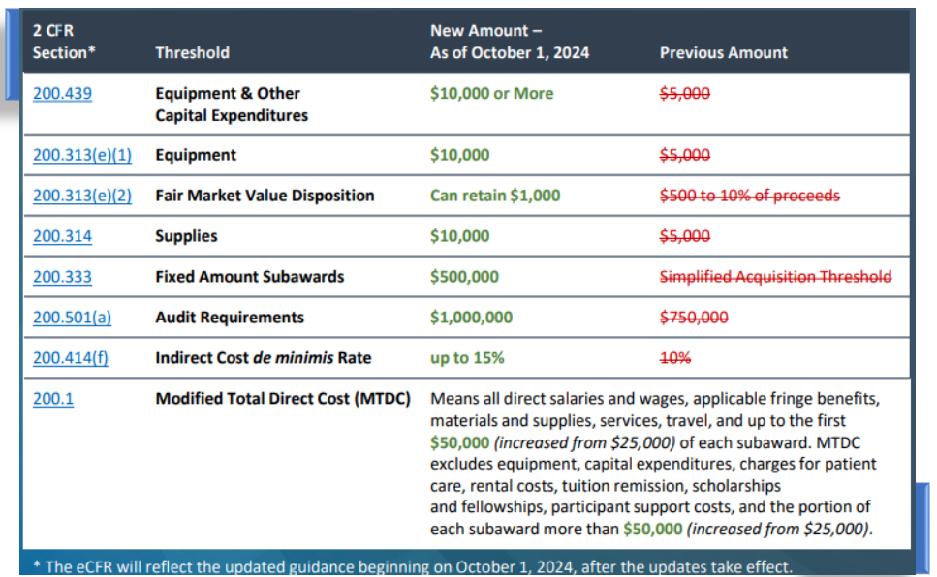

Slide 11
Governing Law: State Statutes
“Agency” means any … business entity acting on behalf of any public agency.
(119.011(2))
New in 2016: §119.0701 (Contracts; public records; request for contractor records; civil action)
§119.071(1)(b) (temporary exemption during procurement process – see also § 286.0013)

Slide 12
Governing Law: State Statutes
125 and 189 – counties and special districts
180.24, 255.0525, and 255.20 – advertising
255.05 – bonds
255.065 – public private partnerships***
688 and 812.081 – trade secrets***

Slide 13
Governing Law: State Statutes Section 287.055
Short Title
Definitions
Public Announcement and Qualification Procedures
Competitive Selection
Competitive Negotiation
Prohibition Against Contingent Fees
Authority of DMS
State Assistance to Local Agencies
Applicability to Design-Build Contracts
Reuse of Existing Plans
Construction of Law

Slide 14
Governing Law: State Statutes
§ 101.293, Fla. Stat. (2022), Voting Machines and Equipment
Purchases.
§ 125.012, Fla. Stat. (2022), Transportation and Port Facilities, Concession Franchises – Counties defined in §125.011(1), Fla. Stat. (2022).
§ 125.031, Fla. Stat. (2022), Lease or lease-purchases of property
for public purpose – county.
§ 125.3401, Fla. Stat. (2022), Purchase, sale, or privatization of water, sewer, or wastewater reuse utility – county.
§ 125.35, Fla. Stat. (2022), Property sale or lease – county, Matheson v. Miami-Dade Cty., 258 So. 3d 516 (Fla. 3d DCA 2018).
§ 125.355, Fla. Stat. (2022), Purchases of real property – county.
§ 130.01-07, Fla. Stat. (2022), Bonds – county.

Slide 15
Governing Law: State Statutes
§ 153.10, Fla. Stat. (2022), et seq., Water and sewer system construction contracts – county.
§ 155.12, Fla. Stat. (2022), Supply purchased for hospitals – Trustees.
§ 157.03-157.07, Fla. Stat. (2022), Drainage projects – county.
§ 166.045, Fla. Stat. (2022), Purchases of real property – Cities that want public record exemption; otherwise bound by charter or ordinance.
§ 180.24, Fla. Stat. (2022), Contracts for Construction – Cities; requires bids on municipal public works projects for construction contracts in excess of $25,000 and on materials or equipment purchases in excess of $10,000.
§ 189.053, Fla. Stat. (2022), Purchases from purchasing agreements of special districts, municipalities, or counties – permits procurement by special districts of commodities and contractual services from purchasing agreements of other local governments.
§ 190.033, Fla. Stat. (2022), Community Development Districts – bids required for purchases in excess of $195,000.

Slide 16
Governing Law: State Statutes
§ 217.15-19, Fla. Stat. (2022), Federal surplus property procurement – city and county, school board, city and county officers.
§ 218.385, Fla. Stat. (2022), Sale of local government bonds.
§ 218.391, Fla. Stat. (2022), Auditor selection procedures.
§ 218.415, Fla. Stat. (2022), Bid requirements for local government investments.
§ 255.103, Fla. Stat. (2022), Authorizes public entities to procure construction management services under the same process outlined in section 287.055, Florida Statutes.
§ 255.20, Fla. Stat. (2022), Local bids and contracts for public construction works – Counties, cities and special districts; projects exceeding $300,000 or $75,000 for electrical work.
§ 255.065, Fla. Stat. (2022), Public-Private Partnerships.
§ 286.043, Fla. Stat. (2022), Airport automobile rental concession – city, county, and other units of local government.

Slide 17
Governing Law: State Statutes
§ 287.055, Fla. Stat. (2022), Consultants Competitive Negotiation Act or “CCNA” – regulates contracting with architects, professional engineers, landscape architects, registered land surveyors and design-builders.
§§ 336.41; 336.44, Fla. Stat. (2022), Competitive bidding on county roadwork.
§ 489.145, Fla. Stat. (2022), Guaranteed Energy, Water, and Wastewater Performance Savings Contracting Act – state, city, or political subdivision
§ 705.103, Fla. Stat. (2022), Sale of abandoned property procedure – city or county.
§ 1013.45, Fla. Stat. (2022), Educational facilities – contains requirements relating to bidding by local school boards.

Slide 18
Governing Law: Related Statutes
§ 50.011, Fla. Stat. (2022), et seq., Language of legal and official advertisements.
§ 50.061, Fla. Stat. (2022), Chargeable amounts legal and official advertisements by size of counties.
§ 119.011, Fla. Stat. (2022), definition of “agency” under public records law includes private corporations acting on behalf of public agencies; see also News & Sun Sentinel v. Schwab, Twitty & Hanser Arch. Group, Inc., 596 So. 2d 1029 (Fla. 1992).
§ 218.70 - .79, Fla. Stat. (2022), Local Government Prompt Payment Act. See Constr. Consulting, Inc. v. Trustees of Broward College, 347 So. 3d 14 (Fla. 4th DCA 2022) (statute does not prohibit waiver of an interest claim as part of a settlement or an accord and satisfaction).
§ 218.80, Fla. Stat. (2022), Public Bid Disclosure Act – requires disclosure on bid documents if fees or permitting are required by the governmental entity; subset act of previously referenced act.
§ 252.38(3), Fla. Stat. (2022), Emergency management powers of political subdivisions.

Slide 19
Governing Law: Related Statutes
§ 255.05, Fla. Stat. (2022), Bond of contractor constructing public buildings – county, city or other public authority.
§ 255.0518, Fla. Stat. (2022), Public bids; bid opening.
§ 255.0705 - .078, Fla. Stat. (2022), Florida Prompt Payment Act.
§ 255.0991, Fla. Stat. (2022), Prohibited local government preferences on projects funded 50% or more by state-appropriated funds.
§ 255.0992, Fla. Stat. (2022), Prohibited governmental actions on public works projects.
§§ 283.32; 336.044, Fla. Stat. (2022), Statutes dealing with recycled products.
§ 286.011, Fla. Stat. (2022), Sunshine Law – applicable to bid evaluation committees, Leach-Wells v. City of Bradenton, 734 So. 2d 1168 (Fla. 2d DCA 1999); Op. Att’y Gen. Fla. 2013-30 (2013).
§ 286.0113, Fla. Stat. (2022), Sunshine Law – temporary exemption for contract negotiation processes, Carlson v. Dep’t of Revenue, 227 So. 3d 1261 (Fla. 1st DCA 2017).
§ 287.084, Fla. Stat. (2022), Preference to Florida businesses for purchases of personal property when low bidder’s home state has local preference.

Slide 20
The Issue and Answer
American Home Assurance Company v. Plaza Materials Corp., 908 So. 2d 360 (Fla. 2005) (4-3)
“The payment bond provisions of all bonds required by subsection (1) shall be construed and deemed statutory payment bonds furnished pursuant to this section and such bonds shall not under any circumstances be converted into common law bonds.” § 255.05(4), Fla. Stat. (added in 2005)

Slide 21
Governing Law: Statute of Frauds
The Statute of Frauds operates as a defense to the enforcement of a contract. Specified agreements must be in writing or evidenced by some type of memorandum to be enforceable. See § 672.201, Fla. Stat. (2022) (Florida’s version of the UCC); §§ 725.01-725.08, Fla. Stat. (2022) (unenforceable contracts). The following are required to be evidenced by a writing:
promises by executors or administrators to pay estates’ debts out of their own funds;
promises to answer for debt/default of another (surety);
promises made in consideration of marriage;
promises creating an interest in land (however, interests for one year or less are generally not subject to Statute of Frauds);
promises that cannot be performed within one year (year runs from date of agreement and not date of performance);
agreements for the sale of goods for $500 or more-except for specially manufactured goods, written confirmation of an oral agreement, admissions in a pleading or court that contract existed, or partial payment or delivery was made and accepted;
health care guarantees;
debt barred by statute of limitations;
newspaper subscriptions;
home solicitation sales;
home improvement contracts;
and credit agreements.

Slide 22
Governing Law: Statute of Frauds
The Statute of Frauds is satisfied if the writing contains the following:
  identity of parties sought to be charged,
  identification of contract’s subject matter, terms and conditions of agreement,
  recital of consideration, and
  signature of party to be charged.
The Statute of Frauds is particularly relevant in relation to change orders and/or amendments in contracts. It is important to document any of these changes in writing in order to avoid litigation or disputes.

Slide 23
Governing Law: Local
No requirement to adopt ordinance proscribing purchasing procedure. Op. Att’y Gen. Fla. 071-366 (1971)
Standard of Review purchasing action
  De novo. Art. V, sec. 21, Fla. Const.
  Overturned with finding of illegality, fraud, oppression, or misconduct. Dep’t of Transp. v. Groves-Watkins Constr., 530 So. 2d 912 (Fla. 1988).
  Public body has wide discretion in FL. Liberty Cty. v. Baxter’s Asphalt & Concrete, Inc., 421 So. 2d 505, 507 (Fla. 1982)

Slide 24
Competitive Procurement Methods
ABA Method: Competitive Sealed Bidding & Competitive Sealed Proposals. FL roughly follows ABA Method and adds Invitation to Negotiate
Competitive Bids: scope easily identified; usually advertised via Invitation to Bid (ITB); primary criteria is PRICE
Competitive Proposals: ITB not possible but scope can be sufficiently identified; usually by Request for Proposals (RFP); in addition to price, factors like experience, proposal, ability, availability can be used & must be disclosed in the RFP; negotiation OK within reason, not for required terms of scope or material terms like price
Invitation to Negotiate: ITB, RFP not possible; enables negotiation with multiple vendors to achieve best value as basis of award. AT&T Corp. v. Dep’t of Mgmt. Servs., 201 So. 3d 852 (Fla. 1st DCA 2016).

Slide 25
Competitive Procurement Methods
Local government has power to develop their own procedures that can mirror state requirements/ABA model code provided that local government complies with applicable statutes. Op. Att'y Gen. Fla. 11-21 (2011).
Piggybacking
  Accela, Inc. v. Sarasota Cnty., 993 So. 2d 1035 (Fla. 2nd DCA 2008) (upholding challenge to “piggyback” contract);
  National Chem. Labs, Inc. v. Broward Cty. School Bd., No. 21-1530 (DOAH Sep. 8, 2021) (applying Accela and rejecting challenge to piggyback transaction).

Slide 26
Competitive Procurement Methods
CCNA § 287.055, Fla. Stat. (2022)
applies to services of an architect, professional engineer, landscape architect, registered surveyor or mapper
for a project: fixed capital outlay or planning study
Related to (1) construction over $325k; (2) planning study or activity fee exceeds $35k
Requirements
  Uniform public announcements
  Competitive selection – NO COMPENSATION UNTIL NEGOTIATION
  Negotiation after ranking
  Must consider if firm is MBE Certified under s. 287.0943, Fla. Stat.
CCNA Continuing Contracts: max construction cannot exceed $4m; Max fee for individual study $500k

Slide 27
Bid Protests: State Claims
Protest Bond
Section 287.042(2)(c), Florida Statutes, requires any person protesting under the APA, to post a bond in an amount equal to 1% of the estimated contract amount at the time of filing the formal written protest.
Local governments can similarly require a protest bond under their governing law. See Zayo Group, LLC v. School Bd. of Polk Cnty., No. 21-1708 (DOAH Sep. 17, 2021) (1% calculation based on initial contract term, not all possible renewals).

Slide 28
Bid Protests: State Claims
Protest Bond
The bond is designed to cover the payment of all costs and charges adjudged against the protestor in the administrative hearing and any subsequent appellate court proceedings. If the agency prevails, it shall recover all costs and charges, excluding attorney's fees from the bond and remainder shall be returned to the protestor.
Depending on the estimated contract amount, 1% of it as the bond requirement could be quite high. Since the purpose of the bond is to secure costs and charges (excluding attorney fees), having a bond amount much larger than necessary may violate constitutional arguments such as access to courts and due process. Cf. Hadi v. Liberty Behavioral Health Corp., 927 So. 2d 34 (Fla. 1st DCA 2006) (reversing order allowing protestor to post $5,000 bond instead of $5,000,000 bond, but leaving open question whether this challenge could be viable in case that does not interfere with ongoing administrative proceeding).

Slide 29
Bid Protests: State Claims
Jurisdictional Requirement
The failure to post a protest bond at the time of filing a formal written protest under section 287.042(2)(c), Florida Statutes, is not jurisdictional. ABI Walton Ins. Co. v. Dep't. of Mgmt. Serv., 641 So. 2d 967 (Fla. 1st DCA 1994); Gen. Elec. v. Dep't of Transp., 869 So. 2d 1273 (Fla. 1st DCA 2004).
Chapter 2006-82, Laws of Florida, amended section 120.57(3)(a), Florida Statutes, to provide that in the notice of a decision concerning a contract award, the notice shall include the following state: "failure to post the bond or other security required by law within the time allowed for filing a bond shall constitute a waiver of proceedings under chapter 120, Florida Statutes.“
In practice, protest bond is sometimes viewed as jurisdictional and fatal to a protest if not filed

Slide 30
Bid Protests: State Claims
Procedural Matters
Type of Review
Notice Procedures
Standing (substantial interest in award)
Bid splitting to avoid procurement requirements not permitted. Mayes Printing Co. v. Flowers, 154 So. 2d 859 (Fla. 1st DCA 1963) (where three sections of a single counter were separately bid in excess of statutory requirement for competitive purchase pursuant to section 125.08, Florida Statutes, an illegal warrant resulted).
Late Bids (may have discretion to accept late bid, if no time specified, time is close of business)
Waiving informalities (Material vs. Non-Material Deviations/Responsiveness)
Mistake
Notes:
a. Type of review
MRO Software, Inc. v. Miami-Dade Cty., 895 So. 2d 1086 (Fla. 3d DCA 2004) (contract award is an executive function, rather than a quasi-judicial act subject to certiorari review).
Orlando-Orange Cty. Expressway Auth. v. Hubbard Constr. Co., 682 So. 2d 566 (Fla. 5th DCA 1996) (authority was an “agency” as defined in the Administrative Procedures Act, chapter 120, Florida Statutes).
b. Notice procedures
Douglas N. Higgins, Inc. v. Florida Keys Aqueduct Auth., 403 So. 2d 1042 (Fla. 3d DCA 1981) (second lowest bidder on project entitled to hearing within 21 days as provided by administrative code provision governing point of entry into proceedings; actual notice in excess of 21 days could not cure failure to notify in accordance with rule). Helicopter Applicators, Inc. v. South Fla. Water Mgmt. Dist., 892 So. 2d 1114 (Fla. 4th DCA 2004) (bid protest may be dismissed when filed months after the bid opening).
c. Standing
National Chem. Labs, Inc. v. Broward Cty. School Bd., No. 21-1530 (DOAH Sep. 8, 2021) (challenge to “piggyback” transaction) AHF MCO of Fla., Inc. v. Agency for Health Care Admin., 308 So. 3d 1136 (Fla. 1st DCA 2020) (bidder deemed non-responsive due to violation of “cone of silence” lacked standing to protest because it would have no chance of obtaining award in a re-bid proceeding). Agency for Health Care Admin. v. Best Care Assurance, LLC, 302
So. 3d 1012 (Fla. 1st DCA 2020) (where economic injuries are alleged as basis for standing in administrative bid protest proceeding, inquiry is whether proceeding contemplates consideration of such interests).
Asphalt Paving Sys., Inc. v. Anderson Columbia, 264 So. 3d 1110 (Fla. 1st DCA 2019) (competitor had standing to challenge contract amendment on basis that work added to contract should have been competitively bid).
Madison Highlands, LLC v. Fla. Housing Finance Corp., 220 So. 3d 467 (Fla. 5th DCA 2017) (“An applicant who submits the fifth lowest bid does not have a substantial interest, unless the applicant can establish that the four higher-ranked applications must all be rejected or re-evaluated, resulting in the protesting filer being ranked highest.”).
Accela, Inc. v. Sarasota Cty., 901 So. 2d 237 (Fla. 2d DCA 2005) (plaintiffs had standing to complain because they were potential competitors with a right to seek a determination of whether competitive bidding was required).
d. Bid splitting

Slide 31
Bid Protests: State Claims
Procedural Matters
Late Bids (may have discretion to accept late bid, if no time specified, time is close of business)
Waiving informalities (Material vs. Non-Material Deviations/Responsiveness)
Mistake (equity/fairness)
Rejecting all bids (public body should reserve the right)
Basis of Award
Time and Effectiveness of Award
Notes:
e. Late bids (Hewitt Contracting Co. v. Melbourne Regional Airport Auth., 528 So. 2d 122 (Fla. 5th DCA 1988) (airport authority had discretion to accept bid for construction work that was ten minutes late). Air Support Servs. Int’l, Inc. v. Metropolitan Dade Cty., 614 So. 2d 583 (Fla. 3d DCA 1993) (when no time is specified, bid is due at the close of business on the date specified).
f. Waiving informalities – material vs. non-material deviations (Responsiveness)
Biscayne Marine Partners LLC v. City of Miami, 273 So. 3d 97 Fla. 3d DCA 2019) (rejecting argument that hearing officer and circuit court were required to undertake independent review of bid responsiveness, recognizing judicial deference due to public body’s contracting decisions). Overstreet Paving Co. v. Dep’t of Transp., 608 So. 2d 851 (Fla. 2d DCA 1992) (bid should not have been declared nonresponsive for missing Disadvantaged Business Enterprise form). Cent. Fla. Equip. Rentals of Dade Cty., Inc. v. Lowell Dunn Co., 586 So. 2d 1171 (Fla. 3d DCA 1991) (no preliminary injunction would lie to prohibit county from awarding bid to next low bidder where lowest bidder had a material irregularity based on its failure to designate single manufacturer and installer of landfill liner and no bidders submitted quality control manuals, which the low bidder claimed was also a material irregularity of the next low bidder). Tropabest Foods, Inc. v. Dep’t of Gen. Servs., 493 So. 2d 50 (Fla. 1st DCA 1986) (irregularity as to beverage mix that did not affect price did not constitute grounds for awarding to another bidder).
g. Mistake
Dep’t of Transp. v. Ronlee, Inc., 518 So. 2d 1326 (Fla. 3d DCA 1988) (bid may not be reformed to correct error, even if subcontractor made a $50,000 error and correcting error still leaves bidder low; however, bidder may be permitted to withdraw bid). Hotel China & Glassware Co. v. Bd. of Public Instruction of Alachua Cty., 130 So. 2d 78 (Fla. 1st DCA 1961) (generally, equity will relieve a unilateral mistake if the public body is informed promptly upon discovery when the mistake is material,
goes to substance, was not occasioned by the lack of due care or diligence, or is the result of neglect). Lassiter Constr. Co. v. Sch. Bd. for Palm Beach Cty., 395 So. 2d 567 (Fla. 4th DCA 1981) (no upward adjustment to compensation made where error in transposing figure for concrete work from bid worksheet to final bid summary sheet was negligently made by the president himself; error was less than 4% of intended bid, and he would still receive some profit). State Bd. of Control v. Clutter Constr. Corp., 139 So. 2d 153 (Fla. 1st DCA 1962) (contractor permitted to withdraw bid where complying in the face of honest mistake of $100,000.00 would work severe hardship upon the bidder, error was not the result of gross negligence or willful inattention, and the error was discovered and communicated before acceptance).
h. Rejecting all bids
Dep’t of Transp. v. Grove-Watkins Constructors, 530 So. 2d 912 (Fla. 1988) (absent fraud, collusion or evidence of means of avoiding competition, no statutory right exists in any bidder to have its bid accepted). Couch Constr. Co. v. Dep’t of Transp., 361 So. 2d 172 (Fla. 1st DCA 1978) (public body should reserve the right to reject all bids, so long as rejection is rational and not arbitrary, when guidelines or specifications are silent on rejection). Milander v. City of Hialeah, 456 So. 2d 588 (Fla. 3d DCA 1984) (city was free to reject all bids and not sell its property to anyone after request for submission of bids on real property). Social Sentinel, Inc. v. Dep’t of Educ., No. 19-0754 (DOAH Apr. 17, 2019) (discussing “arbitrary or illegal” constraint on rejecting all bids under chapter 120, Fla. Stat.).
i. Basis of Award
Valle-Axelberd and Assocs., Inc., v. Metropolitan Dade Cty., 440 So. 2d 606 (Fla. 3d DCA 1983) (where county reserved right to consider factors other than price, county commission exercised discretion to award to other than low bidder). Wester v. Belote, 138 So. 721 (Fla. 1931) (Leading Florida procurement law case relating to the issue of right to reject or right to award bids). Culpepper v. Moore, 40 So. 2d 366 (Fla. 1949) (no mandatory obligation is imposed upon school board to consider the lowest dollar and cents bid as being “the lowest responsible bid” to the exclusion of all other pertinent factors). Liberty Cty. v. Baxter’s Asphalt & Concrete, Inc., 421 So. 2d 505 (Fla. 1982) (county could award to low bidder on road resurfacing contract, notwithstanding that bidder had submitted bid on only one of two alternate asphalt types for which bids were requested). Suburban Inv. Co. v. Hyde, 55 So. 76 (Fla. 1911) (where low bidder refused to submit samples of material on time, county commission had discretion to award to another bidder).
Time and Effectiveness of Award
City of Cocoa v. The Villas of Cocoa Village, LLC, 343 So. 3d 122 (Fla. 5th DCA 2022) (trial court erred by concluding city’s RFP constituted a binding contract that precluded city from terminating negotiations after almost three years and canceling RFP).
City of Miami Beach v. Dickerman Overseas Contracting Co., U.S.A., 659 So. 2d 1106 (Fla. 3d DCA 1995) (though city notified bidder of award, under solicitation terms no contract arose until bidder executed contract).

Slide 32
Bid Protests: State Claims
Substantive Matters
Specificity of Technical Requirements
Requirements Contracts
Exceeding Statutory Requirements
Professional Services
Patent Licenses
Notes:
a. Specificity of technical requirements
Westinghouse Elec. v. Jacksonville Transp. Auth., 491 So. 2d 1238 (Fla. 1st DCA 1986) (requirement that spiral transitions be included in design for people mover system was not exclusionary
where testimony indicated they limit lateral jerk of the vehicles making the ride more comfortable for passengers when negotiating curves, and in light of the fact that the flexibility of the price proposal process encouraged interaction and development of the specifications).
Robinson’s, Inc. v. Short, 146 So. 2d 108 (Fla. 1st DCA 1962) (specifications were too vague where tax collector specification required forms be “securely fastened” where the tax collector knew he would only accept stapling and not gum, glue or crimping. Court held that the specifications must detail to all bidders the standards anticipated, the test the products must meet, and all factors upon which the product will be judged and the award made).
PRIDE v. Dep’t of Highway Safety & Motor Vehicles, Case No. 13-0494BID (DOAH Apr. 10, 2013) (agency intentions ill-defined, and agency failed to succinctly define various terms, contrary to competitive bidding), dismissed as moot, Case No. 13-343 (HSMV May 22, 2013).
b. Requirements contracts
Tavormina v. Dade Cty., 475 So. 2d 1304 (Fla. 3d DCA 1985), (no exclusive contract where Tavormina agreed to provide all the county’s landfill “overburden” on an “as needed” basis where agreement contemplated multiple awards to other contractors from whom the county could use the best bid and where fill was received from other sources on a gratuitous basis), aff’d on appeal following remand, 508 So. 2d 1293 (Fla. 3d DCA 1987).
Dade Cty. v. OK Auto Parts of Miami, 360 So. 2d 441 (Fla. 3d DCA 1978) (guarantee provision of eleven cars per day in a towing contract when read in conjunction with other provisions in the contract indicating that the contractor intended to pay only for what he actually towed in was not absolute, despite the legal requirement that in construing the ambiguous provision most strongly against the drafter, the court was compelled to resolve the question of whether there was any viable guarantee against the county. The court looked to both the document itself and the circumstances surrounding the parties at the time of the contract in order to ascertain the intent of the parties).
Boyd v. Bonded Garages, 160 So. 2d 724 (Fla. 3d DCA 1964) (upon termination of valet parking contract, and award of nonexclusive contract to new bidder, the county retained the authority to prevent previous contractor from conducting business with the county).
Wester v. Belote, 138 So. 721 (Fla. 1931) (where bids were received for 50,000 cubic yards for oyster shell at price per cubic yard f.o.b. lighters, absent fraud, it was permitted to delete language “from time to time as needed”).
c. Exceeding statutory requirements
Reliance Ins. Co. v. Dade Cty., 230 So. 2d 21 (Fla. 3d DCA 1970) (where statute required bonds, “of streets, alleys and other such rights of ways shown on such plats” and bid required bond for, “plats, street signs, sidewalks, drainage structures, necessary fill, bridge and guardrails,” company was required to pay and indemnify the county, and the county could recover on a statutory bond when the requirements of the bond exceeded the requirements of statute).
d. Professional services
Parker v. Panama City, 151 So .2d 469 (Fla. 1st DCA 1963) (revaluation of tangible and real property tax roll in entirety required exercise of special skills and training, therefore charter provision requiring competitive bidding on contracts in excess of $1,000 was not applicable).
City of Pensacola v. Kirby, 47 So. 2d 533 (Fla. 1950) (maintenance of parking meters was not involving peculiar skill and ability so as to be excluded from charter provision requiring competitive bidding).
e. Patent Licenses
Kapsch TrafficCom IVHS, Inc. v. Dep’t of Transp., 249 So. 3d 693 (Fla. 1st DCA 2018) (patent license agreement not one for commodities or contractual services, thus not subject to competitive bidding requirements)

Slide 33
Bid Protests: State Claims
Relief
Miami-Dade Cty. Sch. Bd. v. J. Ruiz Sch. Bus Serv., Inc., et al., 874 So. 2d 59 (Fla. 3d DCA 2004) (even when it is undisputed that school board’s failure to award contract is clearly erroneous, contrary to competition, arbitrary and capricious, damages for lost profits and income are not available).
City of Cape Coral v. Water Servs. of Am., Inc., 567 So. 2d 510 (Fla. 2d DCA 1990) (where unsuccessful bidder relied on representations that its bid would not be rejected for lack of license, bidder was entitled to bid preparation costs, prejudgment interest and attorneys’ fees but not entitled to lost profits.)
Royal Am. Development, Inc. v. City of Jacksonville, 508 So. 2d 528 (Fla. 1st DCA 1987) (after housing authority invited construction proposals, submissions were reviewed, and selections or proposals were recommended, city declined to adopt necessary ordinances, and preconstruction expenditures were awarded on theory of promissory estoppel).
Wood-Hopkins Contracting Co. v. Roger J. Au & Son, Inc., 354 So. 2d 446 (Fla. 1st DCA 1978) (damages, not injunctive relief, are available after award is made).

Slide 34
Bid Protests: Federal Claims
See generally, Kevin F. Foley and David E. Cannella, Disappointed Bidders on Public Projects and Civil Rights Claims Under 42 U.S.C. §1983, Fla. B.J., Mar. 1993, 18. This article compares the results in Pataula Elec. Membership Corp. v. Whitworth, 951 F.2d 1238 (11th Cir. 1992) and United of Omaha Life Ins. Co. v. Solomon, 960 F.2d 31 (6th Cir. 1992). The cases turn on whether state law recognizes a low bidder’s property interest in a contract and whether it requires that the lowest responsible bidder be awarded the public contract. The article also suggests that a claimant should consider asserting a violation of its procedural due process rights if the agency does not have an adequate procedural mechanism to challenge the agency action.
NASA v. Nelson, 562 U.S. 134 (2011) (holding that Constitution does not prohibit government from conducting standard employment background checks on employees of federal contractors; challenged background checks are reasonable, further the Government’s interests in managing its internal operations, and are protected against public disclosure under the Federal Privacy Act of 1974).

Slide 35
Local Preference
Local preference policies/ordinances have been enacted with the goal of providing employment opportunities for local contractors and to ensure continuous work for local businesses in an effort to provide local economic benefits/incentives.
generally granted to a contractor/vendor in a specified geographic area or location, as defined in an ordinance or policy. Such preference policies automatically grant a fixed percentage to a “local” contractor/vendor that submits a bid or proposal. The application of such preference type schemes often have a number of requirements, which include minimum dollar threshold amounts at which such preferences are granted, reciprocity to other cities/counties utilizing similar preferences and waiver provisions for certain agreements such as CCNA and professional service type agreements. The percentage of preference tends to be around 5%.
Tie bids – The most common application of local preferences seems to be with tie bids. In such cases where two bidders/proposers submit bids/proposals tied in price, but otherwise meeting all required conditions, awards are automatically made to the “local” bidder/proposer.

Slide 36
Local Preference
Local preference ordinances or policies have been enacted or adopted with the policy goals of: (1) employing local residents and businesses; (2) reducing local unemployment (i.e., job creation); (3) generating tax revenue in the locality; (4) rewarding local residents and businesses who contribute to the locality through the payment of taxes; and (5) providing continuous, stable work for local residents and businesses. See Steven R. Schooley & Michael W. Andrew, Jr., The Devil in Devolution: State & Local Preference Programs, Construction Lawyer, Oct. 16, 1996, at 18, 18-19.
However, local preference ordinances or policies may come with a number of disadvantages, including: (1) increasing the costs of goods and services caused by a less competitive market; (2) restraining the efficiency and growth of local businesses; (3) failing to address multi-jurisdictional businesses; (4) adding costs for administering/enforcing local preference ordinances and policies; and (5) causing retaliatory local preferences in other jurisdictions. Id. Other disadvantages include increased likelihood of bid protests, creation of barriers to regional and statewide cooperative purchases and making purchases lacking in equity, impartiality and open competition.

Slide 37
Local Preference: Types
Pure local preference ordinances or policies automatically award a fixed percentage in favor of a local bidder; The percentage tends to be around 5%.
Tie bid: awards contract to local business when tied in price
Employment Oriented: preference for bidders who employ a fixed percentage of local citizens/business
Reciprocal: applies a foreign localities preference standards in favor of local bidders competing against foreign bidder.

Slide 38
Local Preference: Challenges
Privileges and Immunities Challenges: Denver v. Bossie, 266 P. 214 (Colo. 1928) (statute providing local preference for in-state products did not subvert or abridge the rights of citizens of other states); Allen v. Labsap, 87 S.W. 926 (Mo. 1905) (no violation of the privileges and immunities clause where the city adopted an ordinance requiring all stone used in public works projects be dressed within the jurisdiction).
Equal Protection Challenges: Am. Yearbook Co. v. Askew, 339 F. Supp. 719 (M.D. Fla. 1972) (statute requiring all public printing be done in the state did not violate the equal protection clause because state was exercising proprietary or business power to contract); Equitable Shipyards, Inc. v. State, 611 P.2d 396 (Wash. 1980) (local preference statute favoring domestic shipbuilders did not violate the equal protection clause because a reasonable basis existed for the preference); Assoc. Gen. Contractors of Cal., Inc. v. City & Cty. of San Francisco, 813 F.2d 922 (9th Cir. 1987) (relieving competitive disadvantage suffered by local businesses due to higher taxes and administrative costs paid to reside in locality and promoting relocation of business to the area are legitimate state interests)
Notes:
Privileges and Immunities Challenges: Denver v. Bossie, 266 P. 214 (Colo. 1928) (statute providing local preference for in-state products did not subvert or abridge the rights of citizens of other states); Allen v. Labsap, 87 S.W. 926 (Mo. 1905) (no violation of the privileges and immunities clause where the city adopted an ordinance requiring all stone used in public works projects be dressed within the jurisdiction). But see United Bldg. & Constr. Trades v. City of Camden, 465 U.S. 208 (1984) (allowing nonresident construction workers to challenge local preference statute on privilege and immunities grounds).
Equal Protection Challenges: Am. Yearbook Co. v. Askew, 339 F. Supp. 719 (M.D. Fla. 1972) (statute requiring all public printing be done in the state did not violate the equal protection clause because state was exercising proprietary or business power to contract); Equitable Shipyards, Inc. v. State, 611 P.2d 396 (Wash. 1980) (local preference statute favoring domestic shipbuilders did not violate the equal protection clause because a reasonable basis existed for the preference); Assoc. Gen. Contractors of Cal., Inc. v. City & Cty. of San Francisco, 813 F.2d 922 (9th Cir. 1987) (relieving competitive disadvantage suffered by local businesses due to higher taxes and administrative costs paid to reside in locality and promoting relocation of business to the area are legitimate state interests); APAC-Miss., Inc. v. Deep S. Constr. Co., 704 S.W.2d 620 (Ark. 1986) (granting local preference to businesses regularly contributing to local economy and providing safeguards and procedures for where public funds are expended are legitimate state interests); Smith Setzer & Sons Inc. v. S.C. Procurement Review Panel, 20 F.3d 1311 (4th Cir. 1994) (providing state benefits to residents supplying them is a legitimate
state interest); Galesburg Constr. Co., Inc. of Wyo. V. Bd. of Tr. Of Mem'l Hosp. of Converse Cty., 641 P.2d 745 (Wyo. 1982) (encouraging local economy is a legitimate state interest).

Slide 39
Local Preference: Challenges
Due Process Challenges: Ex parte Gemmill, 119 P. 298 (Id. 1911) (statute requiring all county printing be done within the county where practicable did not violate the due process clause because the statute did not confine the purchases to residents or citizens of the state); Collins v. Senatobia Bank Book & Stationery Co., 76 So. 258 (Miss. 1917) (statute prohibiting counties from purchasing blank books, stationary and printing services from non-state businesses did not violate the due process clause because no person is entitled as part of his liberty to contract with or perform labor for the state).
Commerce Clause Challenges: Am. Yearbook Co. v. Askew, 339 F. Supp. 719 (M.D. Fla. 1972) (statute requiring all public printing be done in the state did not violate the commerce clause because it had a limited and indirect effect on interstate commerce).
Notes:
c. Due Process Challenges: Ex parte Gemmill, 119 P. 298 (Id. 1911) (statute requiring all county printing be done within the county where practicable did not violate the due process clause because the statute did not confine the purchases to residents or citizens of the state); Collins v. Senatobia Bank Book & Stationery Co., 76 So. 258 (Miss. 1917) (statute prohibiting counties from purchasing blank books, stationary and printing services from non-state businesses did not violate the due process clause because no person is entitled as part of his liberty to contract with or perform labor for the state). But see Kendrick v. City Council of Augusta, Ga., 516 F. Supp. 1134 (S.D. Ga. 1981) (wrongfully rejected bidder is entitled to substantive and procedural due process protections when subjected to arbitrary government action denying a contract.
d. Commerce Clause Challenges: Am. Yearbook Co. v. Askew, 339 F. Supp. 719 (M.D. Fla. 1972) (statute requiring all public printing be done in the state did not violate the commerce clause because it had a limited and indirect effect on interstate commerce). See also Smith Setzer & Sons Inc. v. S.C. Procurement Review Panel, 20 F.3d 1311 (4th Cir. 1994), Big Country Foods, Inc. v. Bd. of Educ., 952 F.2d 1173 (9th Cir. 1992), Trojan Tech., Inc. v. Penn., 916 F.2d 903 (3d Cir. 1990) (local preference statutes did not violate commerce clause because local government was acting as direct market participant); but see W.C.M. Window Co., Inc. v. Bernardi, 730 F.2d 486 (7th Cir. 1984) (state demanding implementation of local preferences is unconstitutional regulation under the commercial clause if the funding and administration of the project is locally controlled).

Slide 40
Local Preference: Florida Law
When a county is purchasing personal property through competitive solicitation, section 287.084, Florida Statutes, allows the county to award a reciprocal local preference to the lowest responsible and responsive vendor whose principal place of business within Florida, in an amount equal to the preference granted by the foreign state or political subdivision in which the lowest responsible and responsive vendor has its principal place of business.
In Adolphus v. Baskin, 116 So. 225 (Fla. 1928), the City of Clearwater awarded a contract to construct a public building to the second lowest bidder because "he is a local man, will use local contractors and local labor, and will patronize local supply houses." Id. at 604. The Florida Supreme Court found that although there was nothing in the City Charter requiring the City Commission to award contracts to the lowest responsible bidder, the City Commission was required to exercise its municipal power in a reasonable manner, and that it was unreasonable to award to the second lowest bidder based on the bidder's local ties because it would "unnecessarily deplete the public fund." Id. at 605.
Notes:
In Marriott Corp. v. Metropolitan Dade Cty., 383 So. 2d 662 (Fla. 3d DCA 1980), the Board of County Commissioners awarded a contract to a vendor on the grounds that it was a local firm, even though the bid of a non-local firm returned a higher percentage of revenues to the County. Id. at 663. The Third District Court of Appeals found that the County adopted by resolution the use of competitive bidding and was required to follow those resolutions. Id. at 665-67. The Third District Court of Appeals held that the Board abused its discretion in awarding the contract to the local firm because: (1) nothing in the record confirmed the firm was in fact local and the lowest bidder was not given an opportunity to
demonstrate it could qualify as a local firm, id. at 668; and (2) the non-local firm was "the best bidder within the standards set by the Board when it elected to solicit competitive bids." Id.
d. In City of Port Orange v. Leechase Corp., 430 So. 2d 534 (Fla. 5th DCA 1983), the City of Port Orange adopted an ordinance granting a pure 3% local preference to firms located in the City and Volusia County. Id. at 535. Based solely on this ordinance, the City awarded a contract to a local bidder, rather than the lower nonlocal bidder. Id. The Fifth District Court of Appeals upheld the ordinance on the grounds that the determination of whether or not to award a local preference is purely a legislative decision and the judicial branch should not overturn such a decision. Id. The Court distinguishes Adolphus and Marriott because both cases lacked a specific local preference ordinance and, therefore, the courts were
reviewing the exercise of power by the executive branch of government as opposed to the legislative branch of government. Id. at 535-36.
e. In Attorney General Opinion 2002-03, the School Board of Alachua County asked whether it may give preference to local firms. The Attorney General opined that the School Board has flexibility in evaluating potential vendors and "knowledge of local conditions" falls within an evaluation of the firms "capabilities“ and "experience." Id. However, the Attorney General cautioned that giving undue weight to the local preference could be contrary to the process of competitive bidding, which could cause the School Board's actions to be arbitrary and capricious. Id.
f. In Attorney General Opinion 2001-65, the Lake County School Board asked if it could adopt a policy giving a local preference in awarding purchasing and professional services contracts. The Attorney General opined that the School Board may adopt such local preference policy as long as such policy does not conflict with statutes or rules on competitive bidding. Id.
g. In Attorney General Opinion 2012-34, the Attorney General opined that a special district has no authority to enact a policy granting a local preference to businesses located within the district absent a statutory authorization for such reference.
h. § 255.0991, Fla. Stat. (2022), prohibits local government preferences on projects funded by state-appropriated funds: a state college, county, municipality, school district, or other political subdivision of the state may not use a local ordinance or regulation that provides a preference based upon: (i) the contractor’s maintaining an office or place of business within a particular local jurisdiction; (ii) the contractor’s hiring employees or subcontractors from within a particular local jurisdiction; or (iii) the contractor’s prior payment of local taxes, assessments, or duties within a particular local jurisdiction.

Slide 41
Contract Performance: Payment & Performance Bonds
Public project payment and performance bonds – Under Florida’s Construction Lien Law, the term "owner" is defined to exclude "any political subdivision, agency, or department of the state, a municipality, or other governmental entity."
§ 713.01(23), Fla. Stat. (2022). Thus, there are no lien rights against public projects. Like most states, Florida has a "Little Miller Act" (based on 40 U.S.C. § 3131), to protect the interests of those involved with public projects.
The Little Miller Act is codified at section 255.05, Florida Statutes. This statute is the subject of the one procurement-related sample question on the certification exam. Before taking the exam, it is worth taking the time at least to read section 255.05. Basically, the statute requires two bond conditions: (1) the prime contractor must perform in a time and manner designated by the contract ("performance bond"); and (2) the prime contractor must make all payments due to those satisfying the definition of "claimant" under the Construction Lien Law ("payment bond"). Local governments have discretion to exempt from this requirement any contract that is for $200,000 or less.

Slide 42
Contract Performance: Payment & Performance Bonds
Public project payment and performance bonds – Under Florida’s Construction Lien Law, the term "owner" is defined to exclude "any political subdivision, agency, or department of the state, a municipality, or other governmental entity."
§ 713.01(23), Fla. Stat. (2022). Thus, there are no lien rights against public projects. Like most states, Florida has a "Little Miller Act" (based on 40 U.S.C. § 3131), to protect the interests of those involved with public projects.
The Little Miller Act is codified at section 255.05, Florida Statutes. This statute is the subject of the one procurement-related sample question on the certification exam. Before taking the exam, it is worth taking the time at least to read section 255.05. Basically, the statute requires two bond conditions: (1) the prime contractor must perform in a time and manner designated by the contract ("performance bond"); and (2) the prime contractor must make all payments due to those satisfying the definition of "claimant" under the Construction Lien Law ("payment bond"). Local governments have discretion to exempt from this requirement any contract that is for $200,000 or less.

Slide 43
Section 255.05 Bonds
making payments to all persons defined in s. 713.01 who furnish labor, services, or materials for the prosecution of the work provided for in the contract.
(18) “Lienor” means a person who is:
A contractor;
A subcontractor;
A sub-subcontractor;
A laborer;
A materialman who contracts with the owner, a contractor, a subcontractor, or a sub-subcontractor; or
A professional lienor under s. 713.03;

Slide 44
Contract Performance: Change Orders and Amendments
Should amendments comply with competitive bidding requirements?
Writing? Contract provisions generally provide that Amendments be in writing. Florida law requires written change orders on public projects where express terms of the governmental entity’s contract contains such a provision. Courts must balance the doctrine of sovereign immunity against holding public entities more accountable for cost increases to contractors.
An implied contract may arise out of an express contract where the contractor is required to perform “extras”; an implied theory is barred only if the express contract concerns the same subject matter as the implied contract. F.H. Paschen, S.N. v. B&B Site Dev., Inc., 311 So. 3d 39 (Fla. 3d DCA 2021).
Damages? If the contractor seeks only to recover damages owed for work performed within the scope of the contract, and not to modify the scope of work, then the contractor is not required to follow mandatory dispute resolution procedures regarding extra work. Miami-Dade Cty. Expressway Auth. v. Elec. Consultants Corp., 300 So. 3d 291 (Fla. 3d DCA 2020).
Notes:
Amendments?
Compare Asphalt Paving Sys., Inc. v. Anderson Columbia, 264 So. 3d 1110 (Fla. 1st DCA 2019) (petition alleging that state agency change order failed to meet statutory requirement for public bidding exemption established party’s standing and entitled it to hearing under Chapter 120, Florida Statutes) and Op. Att’y Gen. Fla. 2003-29 (Jun. 25, 2003) (city may not modify a utility O&M contract to include repairs and capital improvements in excess of no-bid maximums prescribed by city's charter and by state law without seeking bids for additional work)
Grove Key Marina, Inc. v. Sakolsky, 383 So. 2d 695 (Fla. 3d DCA 1980) (where 1973 lease had been executed as the result of competitive bidding process, but there was no competition relating to later amendments, in the absence of requirement of expenditure the amendments were not void).
Writing?
Cty. of Brevard v. Miorelli Eng’g, Inc., 703 So. 2d 1049 (Fla. 1997) (contractor not entitled to recovery for changes without a written change order). b. Ajax Paving Indus., Inc. v. Charlotte Cty., 752 So. 2d 143 (Fla. 2d DCA 2000) (distinguished claim in Miorelli as one for damages not covered in the original contract, whereas Ajax claimed damages for work and materials clearly addressed in the original contract between the parties). c. Acquisition Corp. of Am. v. Am. Cast Iron Pipe Co., 543 So. 2d 878 (Fla. 4th DCA 1989) (enforceability of written change orders).

Slide 45
Contract Performance: Renewal
  Xerox State & Local Solutions, Inc. v. Dep’t of Revenue, 187 So. 3d 386 (Fla. 1st DCA 2016), rejected argument that failure to price renewal term in ITN procurement rendered offer non-responsive, but concluded that it did prohibit agency from later renewing contract.
  Dep’t of Highway Safety & Motor Vehicles v. National Safety Comm’n, Inc., 75 So. 3d 298 (Fla. 1st DCA 2011), discussed a renewal provision essentially identical to section 287.058(1)(f), Florida Statutes, and found mutual agreement of the parties is required for renewal; a unilateral right to renew for does not exist for either the private party or the government).
  Dep’t of Corrections v. C&W Food Serv., Inc., 765 So. 2d 728 (Fla. 1st DCA 2000) (despite renewal clause for two additional one-year periods, renewal is not a unilateral right).

Slide 46
Contract Performance: Termination
  Fla. Envtl. Reg. Specialists, Inc. v. Fla. Dep’t Envtl. Prot., 342 So. 3d 710 (Fla. 1st DCA 2022) (contract “did not require any magic language” to effect termination, and decision to terminate did not implicate open meeting law).
  Northwood Assocs. v. Ertel, 265 So. 3d 665 (Fla. 1st DCA 2019) (legislative proviso language prohibiting use of funds to pay for certain leases not an unconstitutional impairment of contract).
  Handi-Van, Inc. v. Broward Cnty., 116 So. 3d 530 (Fla. 4th DCA 2013), provides detailed discussion of government termination for convenience upholding termination based on state law contract analysis and no sympathy for federal exception against "bad faith" termination.
  Rollins Servs. v. Metro. Dade Cnty., 281 So. 2d 520 (Fla. 3d DCA 1973) (where contract provided that "the authority may at its option and discretion terminate the contract at any time without any default on the part of the contractor by giving written notice to the contractor and a surety at least ten (10) days prior to the effective date of the termination set forth in notice," such unilateral termination provision can be enforced because specifically reserved in the contract).

Slide 47
Contract Performance: Damages
  Broward Cty. v. CH2M Hill, Inc., 302 So. 3d 895 (Fla. 4th DCA 2020) (in professional malpractice claims against licensed engineer and breach of contract claims against contractor, trial court may allocate damages on comparative fault basis pursuant to section 768.81, Fla. Stat., rather than hold breaching parties jointly and severally liable).
  FDEP v. ContractPoint Florida Parks, LLC, 986 So. 2d 1260 (Fla. 2008) (section 11.066, Florida Statutes, does not require specific legislative appropriation before governmental entity can be required to pay valid judgment entered for breach of contract with private entity).
  Martin Cnty. v. Polivka Paving, Inc., 44 So. 2d 126 (Fla. 4th DCA 2010) (to recover damages, contractor must prove that gov’t delay caused indefinite standby, so contractor couldn’t take additional work).
  Triple R Paving, Inc. v. Broward Cnty., 774 So. 2d 50 (Fla. 4th DCA 2000) ("no damage for delay" clause unenforceable when the delay results from fraud or bad faith).
  C.A. Davis, Inc. v. City of Miami, 400 So. 2d 536 (Fla. 3d DCA 1981) (upholding "no damage for delay" clause).

Slide 48
Ethical Considerations
  Section 112.313 (officers, employees, loca gov’t attorneys)
  Section 112.3145 (purchasing agents)
  Criminal Penalties for Self Dealing: Ch. 839, Fla. Stat.
  buyers should be aware of and avoid or mitigate potential organizational conflicts of interest. In some circumstances, a government contractor’s performance on a past or current contract may give it an unfair (or intolerable) advantage over others in future competitive procurement
  situations. See § 287.057(19), Fla. Stat. (2022); see, e.g., Sutron Corp. v. Lake Cty. Water Auth., 870 So. 2d 930 (Fla. 5th DCA 2004) (applying policy of former version of statute to non-state agency); Boston Culinary Group, Inc., v. Univ. of Cent. Fla., No. 17-4509 (DOAH Nov. 21, 2017) (bidder representative’s involvement in drafting solicitation documents grounds for disqualifying bidder from competition).

Slide 49
Governing Law: State Statutes – 112
Solicitation or acceptance of gifts (bribes)
(§112.313(2); see also 838.014 to 838.22)
Unauthorized compensation (gift for influence)
(§112.313(4))
Misuse of public position (§112.313(6))
Disclosure or use of certain information (§112.313(8))
Doing business with one’s agency (§112.313(3))
Conflicting employment or contractual relationship (§112.313(7))
Voting conflicts (§112.3143(3)(a))

Slide 50
Recent Cases
Tallahassee Corp. Ctr. v. DMS, No. 1D21-2007 (1st DCA Nov. 30, 2022) – “deferred” payment and non-appropriation
Constr. Consulting, Inc. v. Trustees of Broward College, 347 So. 3d 14 (Fla. 4th DCA 2022) – prompt payment statutes do not prohibit waiver of an interest claim as part of a settlement or an accord and satisfaction
City of Cocoa v. Villas of Cocoa Village, 343 So. 3d 122 (Fla. 5th DCA 2022) – terminating negotiations after almost three years and canceling RFP

Slide 51
Recent Cases
City of Miami v. Cruz, 342 So. 3d 741 (Fla. 3d DCA 2022) – contractual waiver of sovereign immunity
Fla. Envtl. Reg. Specialists, Inc. v. Fla. Dep’t Envtl. Prot., 342 So. 3d 710 (Fla. 1st DCA 2022) – contract termination
Managed Care v. Fla. Healthy Kids, 268 So. 3d 856 (1st DCA 2019) – trade secrets in proposal
Northwood Assocs. v. Ertel, 265 So. 3d 665 (1st DCA 2019) – non-appropriation not impairment
Biscayne Marine Partners v. Miami, 2019 WL 575327 (3d DCA 2019) – standard of certiorari review
24

Slide 52
Recent AGOs
Tourist development tax to fund contract (2021-02) (& 2020-02, 2019-13, 2019-02, 2017-01, 2016-18)
Hybrid process to select construction manager (2017-02)
Hybrid process to award construction contracts (2011-21)
Alternate forms of security under 255.05 (2015-04)
Continuing contracts under CCNA (2013- 28)

Slide 53
Recent Legislation
Ch 2024-267 US Iron & Steel Contract Provisions s. 255.0993
Ch 2024-184 Human Trafficking Affidavit s. 787.06(13)
Ch 2023-40 E-Verify Provisions
Ch 2023-134 Retainage/Punchlist changes
Ch 2022-2116 – Evidence of vendor financial stability; adding new s. 287.057(27)

Slide 54
Recent Legislation
Ch. 2020-20 (SB 1714) - Sale of surplus state-owned buildings/land
Ch. 2020-119 (SB 178) – Requiring sea level impact projection (SLIP) study before construction in coastal areas
Ch. 2020-127 (HB 441) – amends CCNA “continuing contract”
Ch. 2020-149 (SB 664) – Verification of employment eligibility (E-Verify)
Ch. 2020-154 (HB 279) - Disclosure requirements for local government bidding documents
Ch. 2020-161 (HB 1391) - Florida Digital Service; Financial Technology Sandbox

Slide 55
Question?
You require highly-specialized equipment, available only from a sole provider. The equipment requires specialized installation and housing. The provider, along with its offer to sell the equipment, proposes to engage its trusted and experienced licensed contractor, to design and construct the facility to house the equipment. OK to purchase?

Slide 56
Answer
You require highly-specialized equipment, available only from a sole provider. The equipment requires specialized installation and housing. The provider, along with its offer to sell the equipment, proposes to engage its trusted and experienced licensed contractor, to design and construct the facility to house the equipment. OK to purchase?
No. You “may not contract with an equipment vendor under a sole source contract …, such that the vendor contracts with a licensed general contractor to provide design/build construction services to erect a storage facility for the equipment, without complying with [the CCNA], for those services covered by the act.”
AGO 2009-49

Slide 57
Question?
Your wonderful developer has designed and built an attraction that city residents love to visit and use. The developer specializes in managing such facilities, so you included a property management contract in your competitively negotiated turn-key project solicitation. OK?

Slide 58
Answer
Your wonderful developer has designed and built an attraction that city residents love to visit and use. The developer specializes in managing such facilities, so you included a property management contract in your competitively negotiated turn- key project solicitation. OK?
No. “Competitive bidding and competitive negotiation are different methods for selecting from offers…. An agency may engage in competitive negotiation to obtain certain professional services… [A] property management contract is not among the defined professional services .”
Miami Marinas Ass’n v. City of Miami, 408 So. 2d 615 (Fla. 3d DCA 1981) Today?

Slide 59
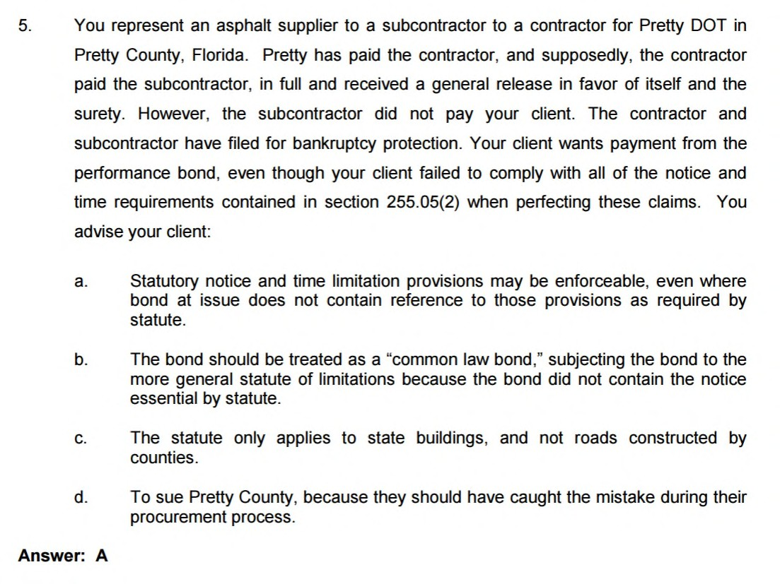
Sample Question

