Slide 1
PUBLIC SECTOR LIABILITY: CIVIL RIGHTS
KIRSTEN MOOD | NABORS GIBLIN & NICKERSON | TALLAHASSEE

Slide 2
Federal Civil Rights Claims
§ 1981
State Con Law
Right to privacy;
Right to access to public meetings and records;
Right of access to the courts;
State Claims
FCRA
Whistleblower
Public Employee Labor Relations
Common Law Torts
§ 1985
§ 1983

Slide 3
FEDERAL CIVIL RIGHTS CLAIMS
Enacted in wake of Civil War and known as Civil Rights Acts of 1866 and 1871
Codified at 42 U.S.C. §§ 1981-85

Slide 4
§ 1981
Guarantees the “same equal rights under the law” to all persons “as is enjoyed by white citizens.”
Amended in 1991, adding new sections:
Define the right to “make and enforce contracts,” and
Protection against violation of rights by “governmental discrimination and impairment under color of state law.”

Slide 5
§ 1981
Contract language used in employment cases – both private and public employers.
§ 1981 applies ONLY to RACE as understood at the time of its enactment in 1866.
Action against state actor must be brought via § 1983 – action cannot proceed if based solely on § 1981.
Unlike Title VII, § 1981 claims require plaintiffs to establish “but-for” causation. Comcast Corp. v. National Association of African-American- Owned Media, 140 S.Ct. 1009 (2020).
Notes:
As a result, federal courts have applied Section 1981 to situations involving discrimination against not only African Americans, but Latinos, Jews, Iraqis, and Arabs. See, e.g., St. Francis Coll. V. Al-Khazraji, 481 U.S. 604 (1987); Shaare Tefila Congregation v. Cobb, 481 U.S. 615 (1987).

Slide 6
FEDERAL CIVIL RIGHTS CLAIMS
Differences | Title VII | Section 1981
Actionable Discrimination | Race, color, religion, sex, & national origin | Race, certain national origins, & religions
Number of Employees | Applies only to employers of 15 or more persons | No such restriction
Individual Liability | No | Yes

Slide 7
§ 1983
Constitution is not self-executing.
When individuals seek to enforce Constitutional rights against a local gov’t, the individual generally must bring suit under § 1983.
Procedural due process, equal protection, free speech, unreasonable search and seizure, etc.
§ 1983 allows an action for damages against any person who, under color of law, subjects any person to a deprivation of any rights, privileges or immunities secured by the Constitution or the law of the United States.

Slide 8
§ 1983
To state a claim, Plaintiff must show:
He was deprived of a right, privilege or immunity secured by the Constitution or Federal law,
The deprivation took place under color of law, and
The act was in furtherance of a “custom or policy”

Slide 9
§ 1983
“Custom or Policy”
  Counties and municipalities may only be held liable if the act taken constitutes a custom or policy of the county/municipality. The local gov’t must be clearly at fault. Its actions must have been the CAUSE of the harm. There is no respondeat superior.
  Single instance of deprivation does not mean local government is safe.
  When action is taken by a gov’t official in whom final policymaking authority has been vested, action constitutes official policy and gov’t potentially can be held liable.

Slide 10

§ 1985
Prohibits various conspiracies to interfere with civil rights, including conspiracies to discriminate against someone based on race and sex.
Extended to protect against conspiracies based on any protected characteristic.
“Conspiracy” means 2 individuals act together.
May be brought against anyone—not just state actors

Slide 11
§ 1985
Elements of claim under § 1985(3):
  a conspiracy;
  for the purpose of depriving equal protection; and
  an act in furtherance of the conspiracy;
  whereby a person is either injured in his person or property or deprived of a right.

Slide 12
FEDERAL CIVIL RIGHTS CLAIMS
WHO CAN BE LIABLE
§ 1981
  any individual who violates the statute;
  counties and municipalities; but,
  generally not state gov’t, unless waived 11th
Amendment Immunity
§ 1983
  counties and municipalities if violation was
due to custom or policy
  not private persons unless engaging in “state action” because of color of law requirement
§ 1985
  private persons/business and governmental entities

Slide 13
FEDERAL CIVIL RIGHTS CLAIMS
DEFENSES
Absolute Immunity
  Available to state and local legislators and judges when sued for damages and, in some instances, for injunctions
  Prosecutors when sued for damages
Qualified Immunity
  Available to gov’t officials in certain circumstances when sued in their individual capacities under sections 1981 and 1983.
  In other words, not available in state tort lawsuit.

Slide 14
FEDERAL CIVIL RIGHTS CLAIMS
When are gov’t officials entitled to Qualified Immunity?
When they act with discretionary authority within the scope of their job duties; AND
Their conduct does not violate a clearly established right of which a reasonable person would have known.

Slide 15
FEDERAL CIVIL RIGHTS CLAIMS
Qualified Immunity
Objective Reasonableness Standard
Government agent gets benefit of the doubt UNLESS actions are so obviously illegal considering then-existing law that only an official who was plainly incompetent or who knowingly violated the law would have committed them.
11th Cir. has held that QI is the rule, not the exception. It provides immunity from SUIT not just from liability. Usually, immediately appealable.

Slide 16
FEDERAL CIVIL RIGHTS CLAIMS
CLEARLY ESTABLISHED RIGHTS CAN BE PROVEN BY
“On point” SCOTUS, Court of Appeals, or state high court case with materially similar facts;
Broad, clearly established constitutional principle that could govern novel facts; or
Conduct where a broad, preexisting constitutional principle applies with obvious clarity.

Slide 17
FEDERAL CIVIL RIGHTS CLAIMS
RELIEF
§ 1981
Injunctive relief, reinstatement, back pay
Punitive damages against a public official and compensatory damages against both the official and the municipality
§ 1983
Injunctive relief, reinstatement, back pay
Punitive damages against a public official and compensatory against municipality and official
Attorneys’ fees and costs

Slide 18
FEDERAL CIVIL RIGHTS CLAIMS
STATUTE OF LIMITATIONS
§ 1983 (presumably § 1985)
  Governed by same SOL as personal injury suits
  In Florida, the 2 year* SOL for tort actions governs
§ 1981
  4-year SOL
  *Recall that tort SOLs in Florida is 2 years generally under §95.11(4)(a), Fla. Stat., and 4 for suits against local governments specifically §768.28(14), Fla. Stat., and the 2 year limitation applies

Slide 19
FEDERAL CIVIL RIGHTS CLAIMS
Excessive Use of Force Graham Factors
  Severity of the crime at issue;
  Whether the suspect poses an immediate threat to the safety of the officers or others;
  Whether the suspect was actively resisting arrest or attempting to evade arrest by flight;
  The relationship between the need and amount of force used; and
  The extent of the injury inflicted.
  Graham v. Connor, 490 U.S. 386 (1989)
Notes:
Graham v. Connor, 490 U.S. 386 (1989)

Slide 20

Sebastian v. Ortiz, 918 F.3d 1301 (11th Cir. 2019)
Sebastian stopped for traffic infraction, complied with stop, refused search of his vehicle.
Court determined that all the Graham factors weighed heavily in Sebastian’s favor and that the case law bars Officer Ortiz’s actions with sufficient clarity (Severity of the crime; whether suspect poses immediate threat;
actively resisting or evading;
Need for force; and extent of injury)
Officer Ortiz forcibly removed Sebastian from vehicle and put handcuffs on in a painful manner.
Sebastian placed in a hot patrol car with only a cracked window and painfully handcuffed

Slide 21
Stephens v. DeGiovanni, 852 F.3d 1298 (11th Cir. 2017)
Eleventh Circuit vacated MSJ ruling in favor of deputy
Facts:
The Deputy investigated Stephens working on parked car and charged him with operating a vehicle without a license
Stephens complied with all the Deputy’s questions and commands
Unprovoked, the Deputy slugged Stephens with all his body weight causing cervical sprains
Court determined that “[o]n these obvious-clarity facts, ‘no particularized preexisting case law was necessary for it to be clearly established what Deputy DeGiovanni did violated Stephen’s constitutional right to be free from excessive use of force’”

Slide 22
FLORIDA CON LAW
Provides additional rights beyond that provided in the U.S. Constitution:
  Right to privacy;
  Right to access to public meetings and records; and
  The right of access to the courts.
Notes:
Board of County Comm’rs of Palm Beach Cnty. v. D.B., 784 So. 2d 585 (Fla. 4th DCA 2001). Appellant's ordinance required adult entertainment performers to provide names and aliases, including stage names, along with residence addresses and telephone numbers. Appellee objected this information would be available to members of the public, who might wish to harass her, under the Florida Public Records Act, Fla. Stat. ch. 119 (1999). Before appellee's right to privacy under Fla. Const. art. I, § 23, which was broader than the federal privacy right, attached, she had to demonstrate a reasonable expectation of privacy. While appellee's right to privacy protected her from governmental intrusion, it did not protect her from public intrusion, which was the gravamen of her complaint. Further, her right to privacy was expressly subservient to the public records act. While certain personal information for certain types of occupations was exempted from public disclosure by Fla. Stat. ch. 119.07(3)(i) (1999), adult entertainment performers were not one of the exempted occupations. Appellee, therefore, had no legitimate expectation of privacy from governmental intrusion and, thus, no right to privacy concerning the information required to obtain an identification card attached.

Slide 23
FLORIDA CON LAW
PRIVACY
  Generally broader than the federal right
  But see Board of Cnty. Comm’rs of Palm Beach Cnty. v. D.B., 784 So. 2d 585 (Fla. 4th DCA 2001).
Notes:
Board of County Comm’rs of Palm Beach Cnty. v. D.B., 784 So. 2d 585 (Fla. 4th DCA 2001). Appellant's ordinance required adult entertainment performers to provide names and aliases, including stage names, along with residence addresses and telephone numbers. Appellee objected this information would be available to members of the public, who might wish to harass her, under the Florida Public Records Act, Fla. Stat. ch. 119 (1999). Before appellee's right to privacy under Fla. Const. art. I, § 23, which was broader than the federal privacy right, attached, she had to demonstrate a reasonable expectation of privacy. While appellee's right to privacy protected her from governmental intrusion, it did not protect her from public intrusion, which was the gravamen of her complaint. Further, her right to privacy was expressly subservient to the public records act. While certain personal information for certain types of occupations was exempted from public disclosure by Fla. Stat. ch. 119.07(3)(i) (1999), adult entertainment performers were not one of the exempted occupations. Appellee, therefore, had no legitimate expectation of privacy from governmental intrusion and, thus, no right to privacy concerning the information required to obtain an identification card attached.

Slide 24
FLORIDA CON LAW
ACCESS TO RECORDS AND PUBLIC MEETINGS
  See 119 and 286
  Government in the Sunshine Manual

Slide 25
FLORIDA CON LAW
ACCESS TO COURTS
  "We find the trial court complied with the requirements of [Florida vexatious litigant law], and reject Brown's claim that the statute violates his right to access to the courts as guaranteed by the Florida Constitution.”
  Brown v. Miami-Dade Cnty., 319 So. 3d 81, 83 (Fla 3d. DCA 2021)
Notes:
Brown failed to file a transcript of the hearing that resulted in his appeal– a duty that falls to the appellee for quasi-judicial actions, explicitly is the burden of the appellant

Slide 26
FLORIDA CIVIL RIGHTS ACT (FCRA, Chapter 760, Fla. Stat.)
COVERAGE
  Same as Title VII, ADA and ADEA
  Race, sex, national origin, religion, disability and age (not limited to 40 or older)
also includes prohibition of discrimination based on marital status
Applies to ERs covered by Title VII, including local and state governments

Slide 27
FCRA
TITLE VII AND THE FCRA
Federal courts look to federal case law interpreting Title VII when analyzing FCRA claims.
Any interpretive changes regarding Title VII may subsequently be applied to the FCRA.
  Examples
    Sex discrimination includes discrimination against a transgender person for gender nonconformity under both Title VII and FCRA.
        Title VII retaliation claims must be proved according to traditional principles of but-for causation since 2013 Supreme Court decision.

Slide 28
FCRA
REMEDIES
  Compensatory
  NO PUNITIVE FOR STATE AND LOCAL GOV’T
  Attorney’s fees and costs
  Jury trial
STATUTE OF LIMITATIONS
  365 days to file a charge of discrimination with FCHR; unlike Title VII which gives 300 days
  EE then has one year to file suit after the FCHR makes a final determination
  If FCHR fails to make a determination within 180 days employee can file suit. No early right to sue letter.

Slide 29
CH. 2020-153, LAWS OF FLA.
On June 30, 2020, Governor DeSantis signed into law CS/HB 255, which amends 760.11, Fla. Stat., and the limitations period for filing a lawsuit alleging a violation of the FCRA.
Prior to the law, if FCHR fails to issue a determination within 180 days, the charging party may proceed as if the FCHR issued a reasonable cause determination and file a lawsuit.
The amendment harmonizes the limitations periods, providing that the 1-year SOL that applies where FCHR issues a timely cause determination also applies where it fails to do so.
The FCHR is required to “promptly notify” the charging party of its failure to issue a determination. The 1-year period begins on the date that notice was sent.

Slide 30
PUBLIC EMPLOYEE LABOR RELATIONS ACT
Protects rights of public employees to take concerted action in furtherance of mutual aims and protects the right to form, join and assist employee organizations.
PERC oversees disputes concerning the representation of public employees by labor unions and allegations of unfair labor practices.

Slide 31
FLORIDA WHISTLEBLOWER ACT
Covers EEs who disclose or threaten to disclose to a governmental agency a violation or suspected violation of misfeasance, malfeasance, waste, or neglect of duties. (Fla. Stat. § 112.3187)
The complaint must be in writing. Does not protect those who disclose information known to be false.

Slide 32
FLORIDA WORKERS COMP
Prohibits discharge or retaliation of an employee for filing a workers' compensation claim. To establish a prima facie case of workers’ compensation retaliation, the employee must show that
(1) he engaged in a statutorily protected activity,
(2) that he was subjected to an adverse employment action and
(3) a causal connection exists between the two.
Atha v. Allen P. Van Overbeke, D.M.D, P.A., 213 So. 3d 1073, 1074 (Fla. 2d DCA 2017).
§ 440.205 does not require an employee to ultimately prove that his pursuit of workers’ compensation was the employer’s only basis for termination. See Juback v. Michaels Stores, Inc., 696 F. Appx 959, 960-61 (11th Cir. 2017).

Slide 33
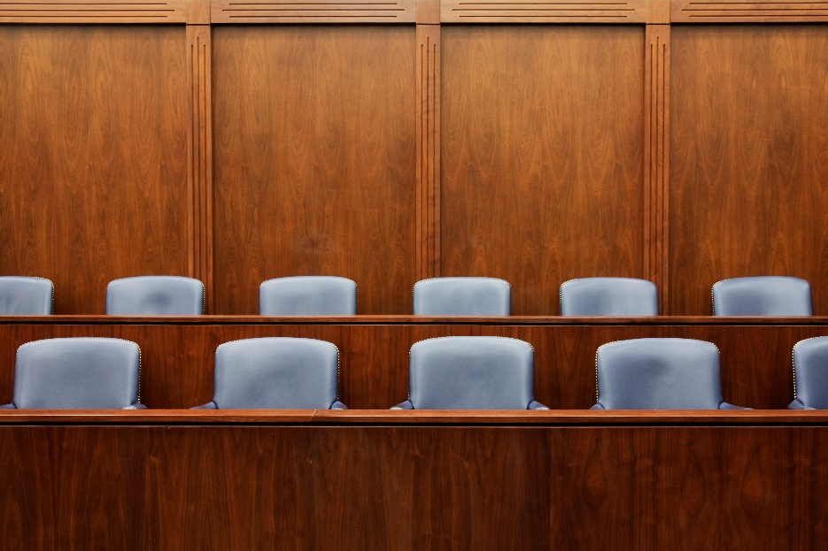
FLORIDA JURY SERVICE § 40.271
Analogous to the Jury System Improvements Act, this state statute prohibits discharge of employees for jury service. This protection applies only to jury service within the state court system and does not apply to jury service in federal courts. See Hill v. Winn-Dixie Stores, Inc., 699 F. Supp. 876, 877-78 (M.D. Fla. 1988); Scott v. Estalella, 563 So. 2d 701, 701 (Fla. 3d DA 1990).

Slide 34
FLORIDA FIREFIGHTERS/POLICE & CORRECTIONAL OFFICERS BILL OF RIGHTS
§§112.80-.112.84, 112.531-112.535 provide procedures for investigating alleged misconduct by firefighters, police officers, or correctional officers. Under the Police Officers’ and Correctional Officers’ Bill of Rights, an employee has the right to bring a civil suit for damages, “pecuniary or otherwise.” FLA. STAT. § 112.532(3).
By contrast, a firefighter bringing a civil suit pursuant to the Firefighters’ Bill of Rights is limited to injunctive relief. See FLA. STAT. § 112.83. See also Curtis v. City of West Palm Beach, 82 So. 2d 894, 896 (Fla. 4th DCA 2011) (holding damages were not an available remedy for violations of Firefighters’ Bill of Rights).

Slide 35
COMMON LAW TORTS
Ordinarily, when an employee commits a wrongful act, the plaintiff will attempt to hold the employer responsible for that act under the doctrine of respondeat superior. This doctrine makes an employer liable for the harm caused by an employee who acted within the course and scope of employment, i.e., to serve the employer's interests.
See, e.g., Canto v. J.B. Ivey & Co., 595 So. 2d 1025 (Fla. 1st DCA 1992).

Slide 36
COMMON LAW TORTS
Until 1973, sovereign immunity foreclosed most suits against state and local
governments for the acts of their employees. Traditionally, sovereign immunity relieved governments from liability to ensure that the public treasury was not unduly burdened by the defense of lawsuits or the payment of claims. Like many other states, Florida gave up most of its sovereign immunity protection by adopting a statutory waiver of immunity:
  No officer, employee, or agent of the state or of any of its subdivisions shall be held personally liable in tort or named as a party defendant in any action for any injury or damage suffered as a result of any act, event, or omission of action in the scope of her or his employment or function, unless such officer, employee, or agent acted in bad faith or with malicious purpose or in a manner exhibiting wanton and willful disregard of human rights, safety, or property.
FLA. STAT. § 768.28(9)(a) (Emphasis added).

Slide 37
COMMON LAW TORTS
Three categories of conduct will overcome a government employee’s individual immunity:
bad faith,
malicious purpose, and
wanton and willful disregard of human rights, safety or property.
Johnson v. City of Daytona Beach, No. 6:16-cv-941-Orl-40TBS, 2017 WL 119744, at *6 (M. D. Fla. Jan. 12, 2017).

Slide 38
COMMON LAW TORTS
NEGLIGENT HIRING AND RETENTION
A negligent hiring or retention suit is unlike most suits in that it is specifically designed to hold the employer responsible for acts of an employee outside the course and scope of employment. Garcia v. Duffy, 492 So. 2d 435, 438 (Fla. 2d DCA 1986). See also City of Boynton Beach v. Weiss, 120 So. 3d 606, 610 (Fla. 4th DCA 2013).
Government employers should assume that these torts will be applied to them. See Slonin v. City of West Palm Beach, 896 So. 2d 882, 884 (Fla. 4th DCA 2005) (finding no sovereign immunity for negligent retention or supervision).
Notes:
For that reason, it may be prohibited by the last
sentence of § 728.28(9)(a), which provides that the state shall not be held liable in tort for the act
of an employee outside the course and scope of employment. However, unless this issue is resolved
by the Florida Supreme Court, government employers should assume that these torts will be
applied to them. See Slonin v. City of West Palm Beach, 896 So. 2d 882, 884 (Fla. 4th DCA 2005)
(finding no sovereign immunity for negligent retention or supervision).

Slide 39
COMMON LAW TORTS
NEGLIGENT HIRING
To show negligent hiring, a plaintiff must prove that:
• the employer owed a duty to the plaintiff to exercise reasonable care in the selection of an employee to perform particular duties;
• the employer failed to make an appropriate investigation;
• appropriate investigation would have revealed the unsuitability of the employee for the particular duty to be performed or for employment in
general;
• the plaintiff was harmed by an independent wrongful act committed by the
employee;
• the independent wrongful act was of a type foreseeable in light of the
employee's particular unsuitability; and
• the employer's unreasonable failure to investigate was a legal cause of the
Plaintiff's injury.
Garcia, 492 So. 2d at 440.

Slide 40
COMMON LAW TORTS
NEGLIGENT RETENTION
To show negligent retention, a plaintiff must prove that:
• the employer owed a duty to the plaintiff to exercise reasonable care in the
retention of an employee to perform particular duties;
• the employer received actual or constructive notice that the employee it
retained was unfit to perform these duties;
• the employer unreasonably failed to take corrective action reasonably
calculated to prevent harm to the plaintiff;
• the plaintiff was harmed by an independent wrongful act committed by the
employee;
• the independent wrongful act was of a type foreseeable in light of the
employee's particular unfitness for duty; and
• the employer's unreasonable failure to take corrective action was a legal cause of the Plaintiff's injury.
Garcia, 492 So. 2d at 441.

Slide 41
COMMON LAW TORTS
DEFENSES
An employer can escape liability by proving the absence of notice to the employer that the employee who caused the harm was unfit for duty. See M.V. By & Through W.W. v. Gulf Ridge Council Boy Scouts of Am., Inc., 529 So. 2d 1248, 1248 (Fla. 2d DCA 1988)
Other defenses include proof that the employer took reasonable steps to avoid harm and proof that the wrongful act committed by the employee was not foreseeable from the information available to the employer. See Iglesia Cristiana La Casa Del Senor, Inc. v. L.M., 783 So. 2d 353, 358-59 (Fla. 3d DCA. 2001)

Slide 42
COMMON LAW TORTS
ASSAULT AND BATTERY
Assault
an intentional
offer or threat of bodily injury to another
under such circumstances as to create a fear of imminent peril
where defendant possessed the apparent present ability to carry out the offer or threat
See United States v. Guilbert, 692 F.2d 1340, 1343 (11th Cir. 1982), cert. denied, 460 U.S. 1016, 75 L. Ed. 2d 487.
Battery
the intentional infliction of
a harmful or offensive contact
upon the person of the plaintiff
See Chorak v. Naughton, 409 So. 2d 35, 39 (Fla. 2d DCA 1981).

Slide 43
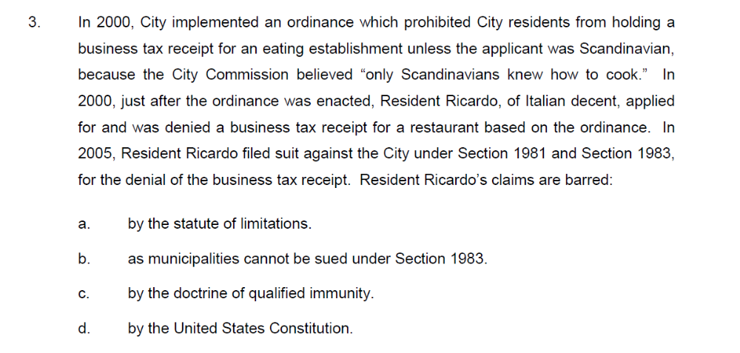
CIVIL RIGHTS

Slide 44
CIVIL RIGHTS

Slide 45
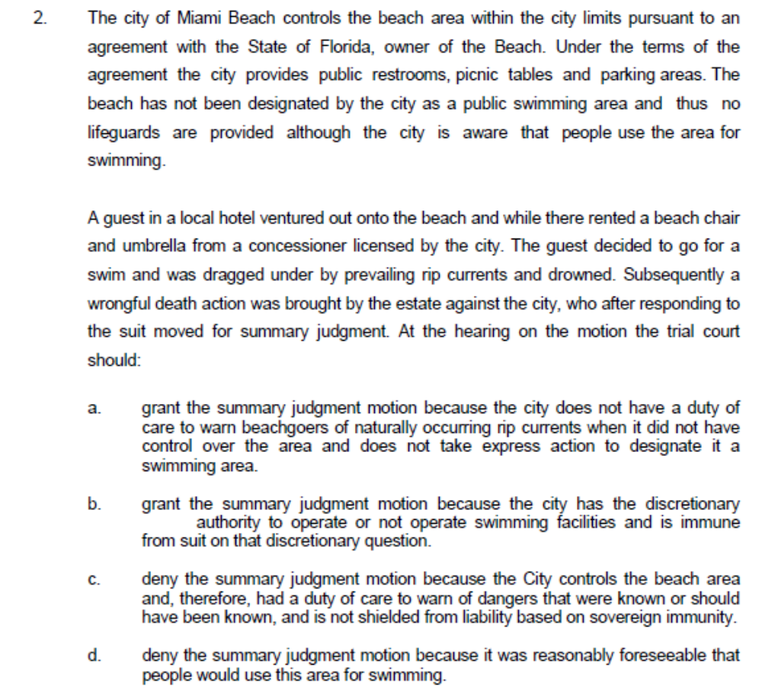
SOVEREIGN IMMUNITY

Slide 46

SOVEREIGN IMMUNITY

